Slide 1
The Skeletal System
Know the structure and functions of the skeletal system
Know the roles that the skeletal system performs

Slide 2
Functions of the skeletal system
With a partner discuss the functions of your skeleton. How many of the 5 functions can you identify?
Movement at joints
Support for muscles and vital organs
Shape
Protection such as skull protecting the brain
Blood-cell production in the bone marrow

Slide 3
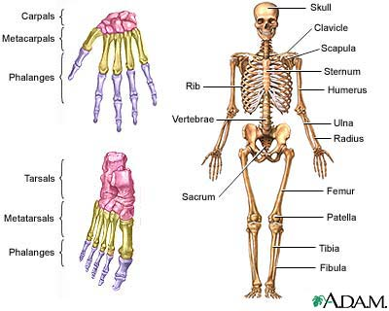
The Skeleton

Slide 4
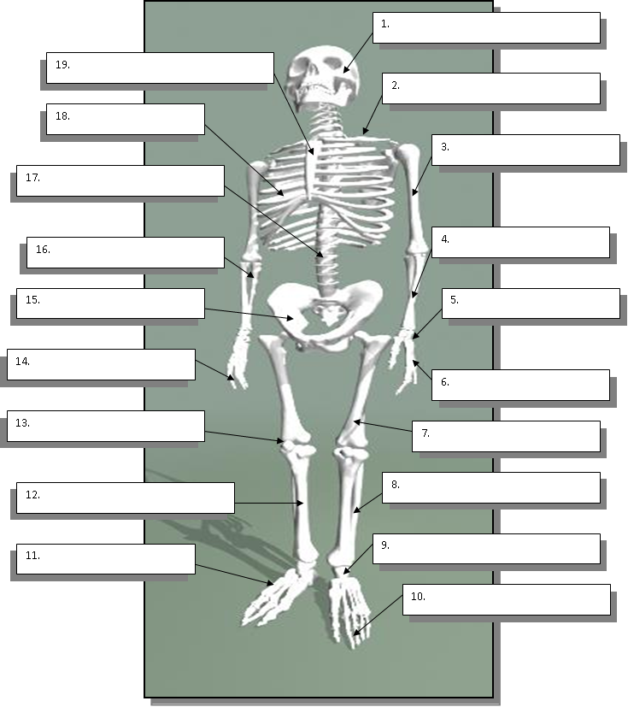
Name the numbered bones:
1
3
4
7
10
11
12
15
18
19
Total – 10 marks

Slide 5
Test your knowledge
Humerus = 1
Phalanges = 6
Cranium = 5
Fibula = 9
Patella = 3
Tibia = 8
Sternum = 7
Femur = 4
Scapula = 2
Complete the following calculation:
Shin bone
Plus Thigh bone
Minus Skull
Multiplied by Kneecap
Dividied by Breastbone
= ?????
And the answer is………3

Slide 6
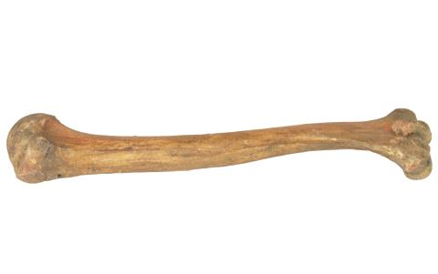
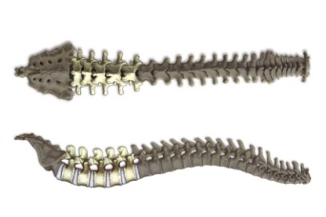
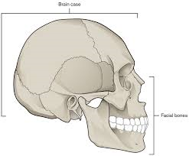
Bones
Long Bones
Short Bones
Such as the femur
Such as the metacarpals
Flat Bones (Plate bones)
Irregular Bones
Such as the cranium
Such as the vertebrae

Slide 7
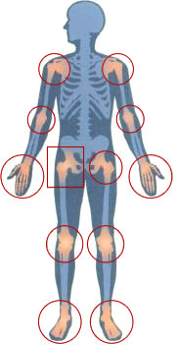
Joints
Movement can only happen when the skeletal system is joined by the muscular system
All movement occurs at Joints, which is where 2 (or more) bones meet
Joints are classified according to how much movement they allow...
Freely moveable or Synovial
Slightly moveable (Vertebrae in your spine)
Immoveable or fixed (Many bones in the Skull)
We are mostly concerned with Synovial joints since they allow more movement...
Hinge- Elbow and Knee
Ball and Socket- Hip and Shoulder
Pivot- Radio-ulnar joint
Saddle- Thumb
Gliding- Hand
Condyloid- Wrist

Slide 8
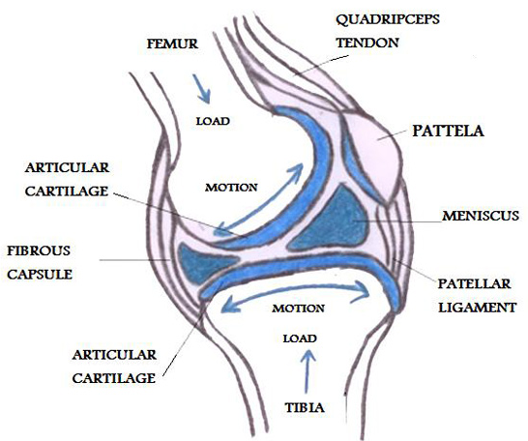
Connective tissue
Tendons, ligaments and cartilage play an important role in all joints. Do you know the difference between them?
Tendons
Very strong, non-elastic cords
Join muscle to bone
Ligaments
Bands of fibre attached to bones
Keep the joint stable
Cartilage
Tough but flexible tissue
Acts as a buffer between bones

Slide 9
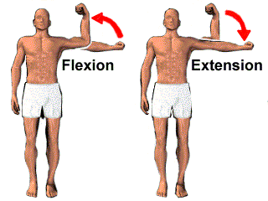
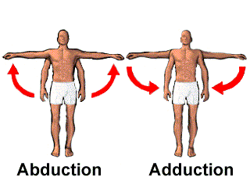
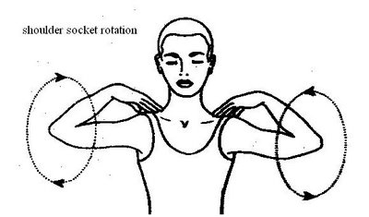
Movement
Considered to be the main role of the skeletal system
There are specific names given to specific movements...
Flexion- decreasing of an angle at a joint
Extension- increasing of an angle at a joint
Abduction- movement of limb away from midline of body
Adduction- movement of limb towards midline of body
Rotation- movement of limb freely in a curve

Slide 10
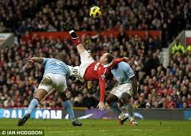
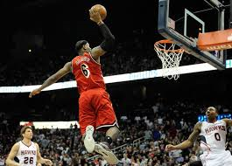
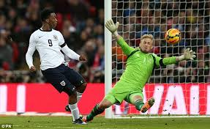
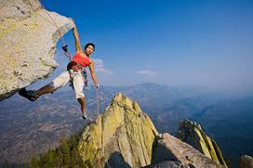
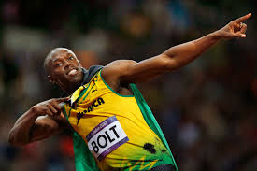
Name as many types of movement as you can in each photo

Slide 11
Test your knowledge
Cover your notes from the lesson and try these….
State 4 of the functions of the skeletal system. (4 marks)
Name 3 bones which are located in your leg. (3 marks)
Name the 4 different ‘types’ of bone. (4 marks)
Which word, beginning with an S, describes joints which allow movement? (1 mark)
What types of joint is found at the elbow and the hip? (2 marks)
State a difference between tendons and ligaments. (1 mark)
A bicep curl would involve which type of movement at the elbow joint? (1 mark)
Total = 16 marks
8 or less = more revision needed!
9-12 = a good effort
12-15 = working to an A standard!
16 = totes amazeballs!!!

