Slide 1
The Muscular System
Identify different types of muscle
Name the main muscles
Understand the way in which muscles enable movement to occur

Slide 2
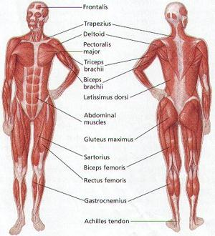
Skeletal muscles

Slide 3
Label your volunteer
In small groups choose one volunteer to be your model. Write the each of the 10 muscles listed below on post-it notes and stick them in the correct place.
You have 3 minutes to try to score full marks!
LATISSIMUS DORSI
GASTROCNEMIUS
DELTOIDS
TRICEPS
TRAPEZIUS
ABDOMINALS
QUADRICEPS
BICEPS
PECTORALS
HAMSTRINGS

Slide 4
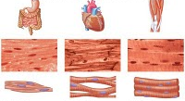
Types of muscle
There are 3 types of muscle...
Skeletal muscle (Voluntary muscle)
Majority of muscles in the body
Help give the body shape
Only act under conscious control
Cardiac muscle
Found in the walls of the heart
Work without conscious control- ensuring heart continues beating
Involuntary muscle
Found in the walls of the intestines and blood vessels
Work without conscious control- ensuring crucial body functions continue

Slide 5
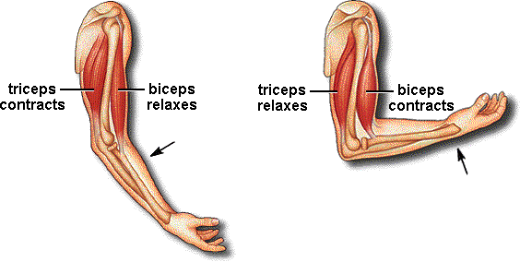
Muscles and Movement
Muscles can only pull on bones...
This is why they work in Antagonistic pairs with one pulling in one direction while the other relaxes (and vice versa)
Agonist (Prime mover)
Muscle that initiates movement by contracting
Antagonist
Muscle which relaxes to allow movement to occur
Origin
End of muscle attached to fixed bone
Insertion
End of muscle attached to bone which moves

Slide 6
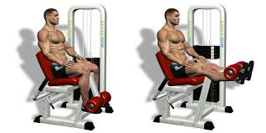
Quick quiz!
Look at the diagram above:
Name the muscle which is working during this exercise (1 mark)
What type of muscle is it? (1 mark)
With which muscle does it work to form an antagonistic pair? (1 mark)
Name the type of movement occurring at the knee joint from the first position into the second. (1 mark)
The biceps and triceps also work as an antagonistic pair. When lifting the weight for a bicep curl what term could be given to a) the bicep, and b) the tricep? (2 marks)
Total = 6 marks

Slide 7
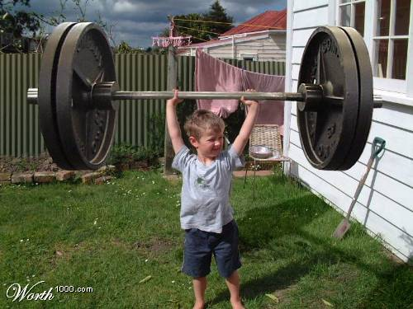
Muscular contractions
Muscles can be grouped according to the movement they enable...
Flexors and Extensors
Bend or straighten a limb by contracting
Name 2 flexor and 2 extensor muscles in your body.
Adductors and Abductors
Move limb towards or away from the midline
of the body by contracting

Slide 8
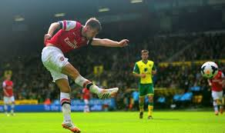
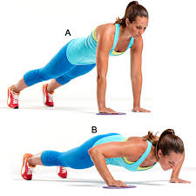
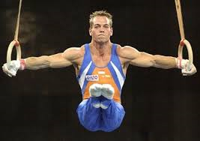
Types of muscle contraction
When muscles contract they do so in one of two ways...
Isotonic contractions
Where the muscle contraction while moving
Concentric- Shortening of muscle
Eccentric- Lengthening of the muscle
Isometric contraction
No movement
Muscles are working to keep joint stable
For the 3 diagrams below discuss with a partner which you think shows an isotonic concentric contraction, which is an isotonic eccentric contraction and which is an isometric contraction.

Slide 9
Major muscles in movement
The following muscle in pairs (and groups) allow major movement...
Biceps and triceps
Movement in the arm
Any types of throwing (Javelin, Cricket, Tennis, Volleyball)
Hamstrings and Quadriceps
Movements in the leg
Kicking a football and running movements (Sprinting and jogging)
Abdominals
Allow movement of the core
Important for keeping body straight upright in a variety of movements
Pectorals
Allow arm to be raised at the shoulder
Tennis drive shot, shot putt and swimming strokes
Gastrocnemius
Initial movements in the legs
Start of running and take off in jumping

Slide 10
Test your knowledge
Name the two muscles of the upper arm and the two muscles of the upper leg. (2 marks)
Name the 3 types of muscle. (3 marks)
What is the difference between an agonist and an antagonist? (1 mark)
Define the term ‘insertion’. (1 mark)
What do adductor muscles do? (1 mark)
Define the two types of isotonic muscle contractions (2 marks)
Other than a gymnastic event, give a sporting example of when an isometric contraction will take place. (1 mark)
When kicking a football which muscle is the prime mover? (1 mark)
Total = 12 marks
6 or less = not great, revision tonight!
7-11 = a decent effort on a tough topic
12 = you the man (or woman)!!!

