Slide 1
Skill Acquisition
Understand what skills are and how they can be developed
Be aware of different types of guidance available
Be aware of different types of practice

Slide 2
Skill Acquisition
Skill is using knowledge or expertise to succeed
They can be considered in 2 categories:-
Basic Skills
Simple skills such as throwing, catching, running and jumping. They are needed before you can move on to attempt higher level skills
Complex Skills
Skills which take quite a long time to learn, involving higher levels of co-ordination and control. Usually sports specific

Slide 3
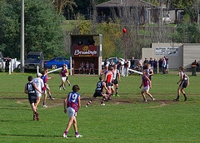
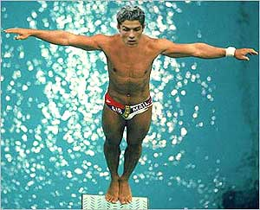
Types of skill
Open Skills
Occur in a constantly changing situation (Invasion game activity)
As the environment changes the skill may need to be adapted.
Passing in Rugby, dribbling in football etc.
Closed Skills
Occur in stable environment
Not affected by the sporting environment
Gymnastics routine, long jump, shot putt etc.

Slide 4
Open and Closed Skills
Place the following skills on the continuum below and discuss with a partner your justification for your choices.
A – forward roll in gymnastics
B – serve in tennis
C – volley in football
D – serve in badminton
E – dribbling past an opponent in hockey
Closed -------------------------------------------Open

Slide 5
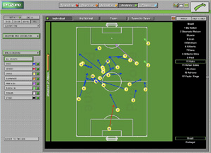
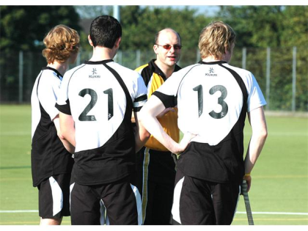
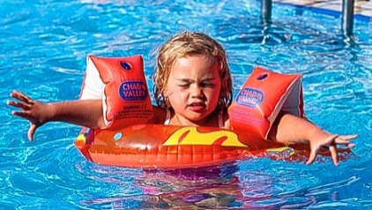
Guidance
Visual
Seeing a demonstration happen, watching a dvd of a previous performance watching a recording of opposition’s last game
Verbal
Being told what needs to be done, what went well or what needs improvement
Manual/Mechanical
Being physically guided through something, supported in a gymnastic vault.
Mechanical is guided by a device, such as a harness at trampolining or armbands

Slide 6
Feedback
A performer needs to know how good their performance was, they can get feedback in a variety of ways…
Intrinsic- is sensed or felt by the performer while they are actually performing
Extrinsic- comes from external sources, sounds or things they can see
Knowledge of performance- Considering how well the team performed
Knowledge of results- Concerned only with the outcome of the performance

Slide 7
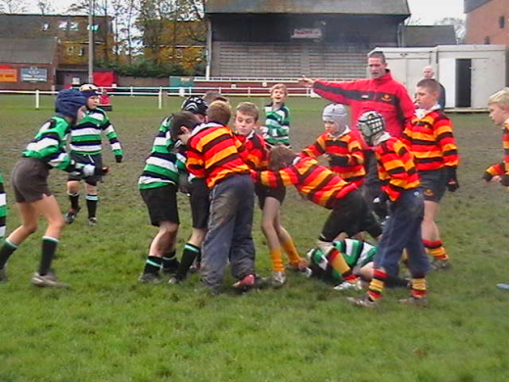
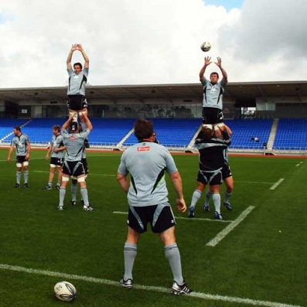
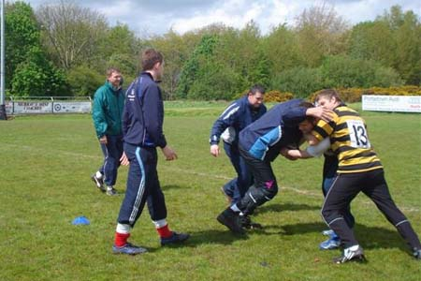
Types of practice
Whole- complete performance carried out with all performance covered
Part- Only specific aspects of the skill are targeted for development
Fixed- A set session or aspect is concentrated upon
Variable- Combination of all the above

Slide 8
Test your knowledge
Define the term ‘open skill’ and provide an example of a skill that is predominantly open (2 marks)
Name the three types of guidance which can be used when coaching a new skill. (3 marks)
Describe the difference between intrinsic and extrinsic feedback. (2 marks)
Which type of feedback is concerned with the outcome of an event? (1 mark)
Define the terms whole and part practice. (2 marks)
Total = 10
0-6 = poor, more revision needed asap!
7-8 = room for improvement but a great effort
9-10 = awesome performance, keep it up and that A* is yours!

