Slide 1
Components of Fitness
LO: Understand the two types of fitness.
LO: Be able to name and describe the different components of fitness.
LO: Be able to describe how each component of fitness is important for different activities.

Slide 2
Types of Fitness
The two types of fitness are:
Health-related fitness
AND
Skill-related fitness

Slide 3
Health-Related Fitness
What are the five components of health-related fitness?
Strength
Speed
Power
Cardiovascular endurance
Flexibility

Slide 4
Strength
“The ability to bear weight”, strength can be divided into three categories:
Dynamic strength
the strength needed for sportspeople to support their body weight for a prolonged time, or to be able to apply force against an object.
Explosive strength
used in one short , sharp, burst or movement.
Static strength
the greatest amount of strength that can be applied to an immovable object.

Slide 5
Strength
Discuss examples within specific sports/ sporting scenarios, when each type of strength is required.
Dynamic
Explosive
Static
Activities often require a degree of each.

Slide 6
Power
A combination of the maximum amount of speed with the maximum amount of strength.
Closely linked to explosive strength.
Can’t be maintained for long periods of time.
Can be improved through training.

Slide 7
Speed
The ability to move all or parts of the body as quickly as possible.
A combination of Reaction time and Movement time.
The fastest man alive!
Can this be improved through training?

Slide 8
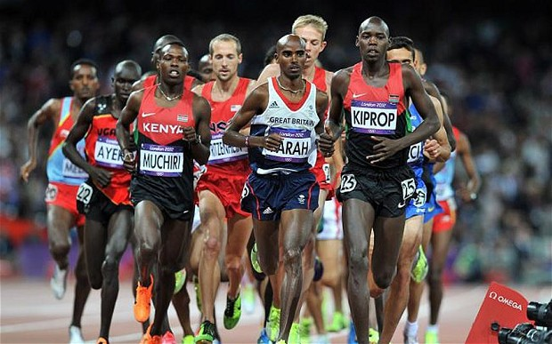
Cardiovascular endurance
Often referred to as stamina.
The ability of the heart and lungs to keep operating efficiently during an endurance event.

Slide 9
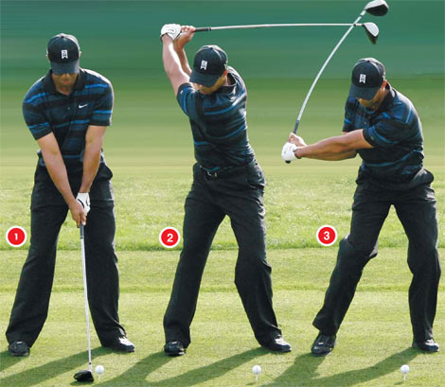
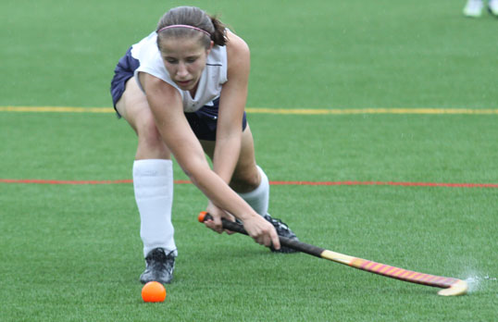
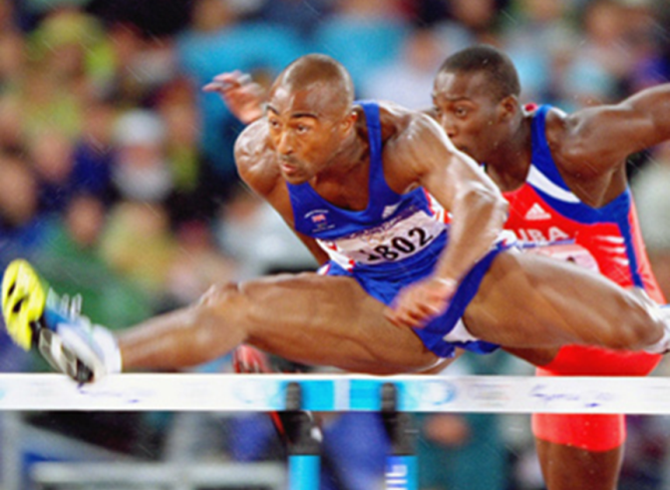
Flexibility
Often called “suppleness”.
Defined as the “range of movement around a joint”.
Flexibility can:
Make a performance more effective and more efficient.
Reduce the chances of injury.
Improve body posture.
How can this be improved?

Slide 10
Choose 3 different sports/activities and outline the most important types of health-related fitness required in each.
SPORT | TYPE OF HEALTH-RELATED FITNESS | WHY IS IT IMPORTANT?
Hurdles | Flexibility | To be able to reach with lead leg and get into a position to clear the hurdle as fast as possible.

Slide 11
Quick Quiz
Name the three types of strength (3 marks)
Define the term flexibility (1 mark)
Which term is also referred to as stamina? (1 mark)
Speed x Strength = ?? (1 mark)

Slide 12
Skill-Related Fitness
The 5 factors of skill-related fitness are:
Agility
Balance
Co-ordination
Reaction Time
Timing

Slide 13
Agility
A combination of speed and flexibility.
The ability to change direction quickly.
This can be improved through training and is very important in invasion games.
Beating defenders!

Slide 14
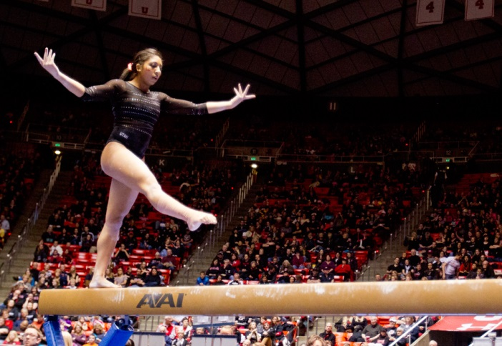
Balance
The ability to maintain a given posture in a static or dynamic situation.
This is very obvious in gymnastics.
It is also closely linked to agility as you need to maintain balance while changing direction.

Slide 15
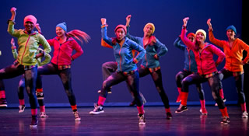
Co-ordination
This describes the ability to link different parts of a movement together to produce a smooth performance.
It could be synchronising what you see with what you then do or being able to move different parts of the body in dance.

Slide 16
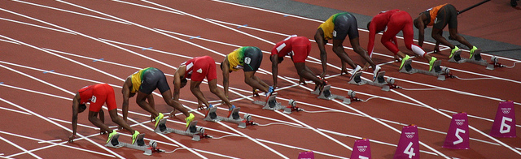
Reaction Time
This involves responding to a stimulus.
Simple reaction time involves reacting to something once it happens i.e 100m start.
Choice reaction time is more open and allows the person to decide when to move based on the stimulus. i.e when to tackle in hockey, football etc.

Slide 17
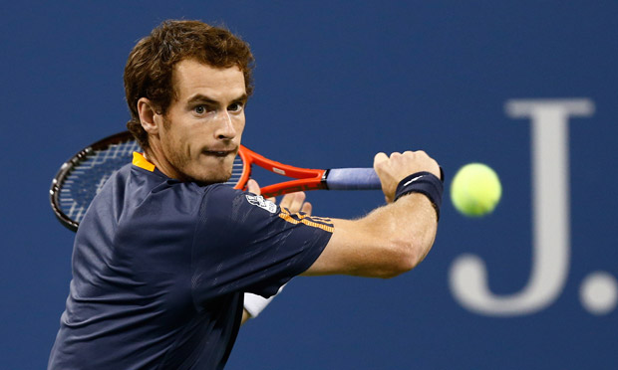
Timing
…is the ability to match movements with external factors…
…such as striking a rounders ball as it is bowled, or returning a tennis serve.
It requires a combination of reaction time and co-ordination.

Slide 18
Choose 3 different sports/activities and outline the most important types of skill-related fitness required in each.
SPORT | TYPE OF HEALTH-RELATED FITNESS | WHY IS IT IMPORTANT?
100m | Reaction Time | To be able to start moving as soon as the gun goes off, to get ahead of the opposition.

Slide 19
ELT
Fitness Testing
Research a specific fitness test for each type of fitness and present them all with a description and supporting diagrams/pictures.

Slide 20
Quick Quiz
Define the term ‘coordination’ (1 mark)
Agility is a combination of which two components of fitness (2 marks)
Name two types of balance (2 marks)
Name and define the two types of reaction time (4 marks)
Which term is defined as the ability to match movements to external factors? (1 mark)

Slide 21
Fitness Testing

Slide 22
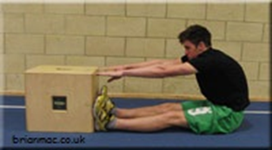
Flexibility – Sit and Reach Test
The assistant secures the ruler to the box top/ bench with the tape so that the front edge of the box lines up with the 15cm (6 inches) mark on the ruler and the zero end of the ruler points towards the athlete
The athlete sits on the floor with their legs fully extended with the bottom of their bare feet against the box
The athlete places one hand on top of the other, slowly bends forward and reaches along the top of the ruler as far as possible holding the stretch for two seconds
The assistant records the distance reached by the athlete’s finger tips (cm)
The athlete performs the test three times
The assistant calculates and records the average of the three distances and uses this value to assess the athlete’s performance

Slide 23
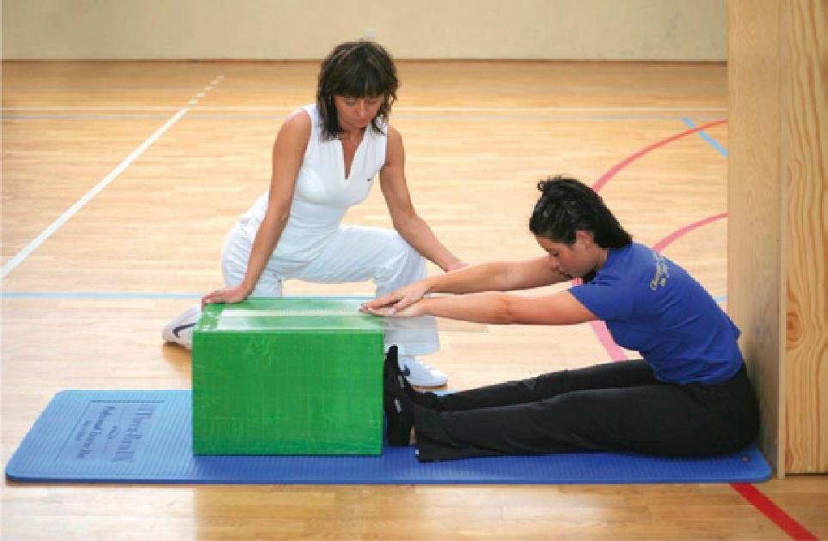

Slide 24
Strength – Hand Grip Test
The athlete using their dominant hand applies as much grip pressure as possible on the dynamometer
The assistant records the maximum reading (kg)
The athlete repeats the test 3 times
The assistant uses the highest recorded value to assess the athlete’s performance

Slide 25
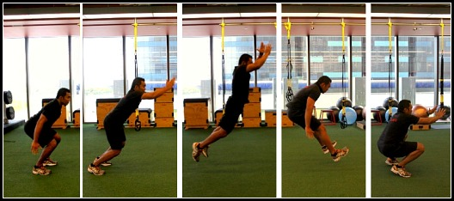
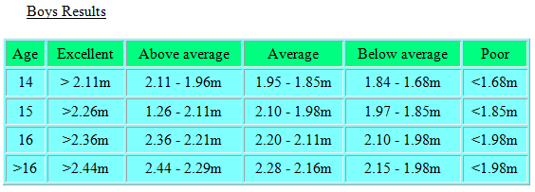
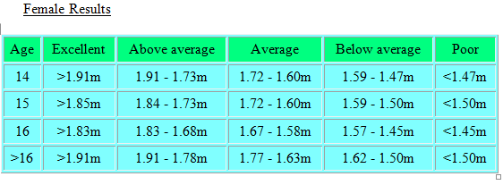
Power - Standing Broad Jump
The athlete places their feet over the edge of the sandpit, crouches down and using the arms and legs jumps horizontally as far as possible landing with both feet into the sandpit.
The assistant measures and records the distance from the edge of the sandpit to the nearest impression made by the athlete in the sand pit.
The athlete repeats the test 3 times.
The assistant uses the longest recorded distance.

Slide 26
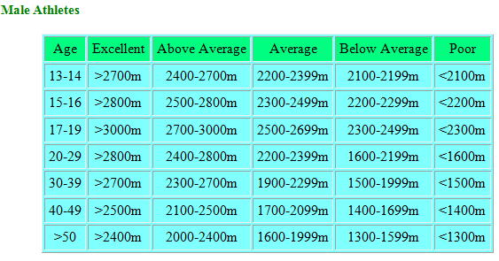
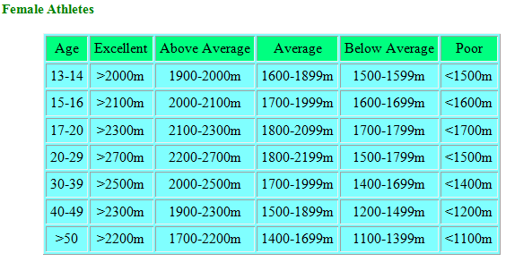
CV Endurance – Cooper Run
This test requires the athlete to run as far as possible in 12 minutes.
The assistant keeps the athlete informed of the remaining time at the end of each lap (400m)
The assistant blows the whistle when the 12 minutes has elapsed and records the distance the athlete covered to the nearest 10 metres

Slide 27
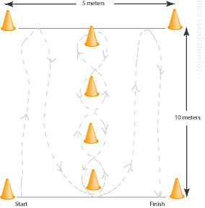
Illinois Agility Test
Subjects should lie on their front (head to the start line) and hands by their shoulders.
On the 'Go' command the stopwatch is started, and the athlete gets up as quickly as possible and runs around the course in the direction indicated, without knocking the cones over, to the finish line, at which the timing is stopped.

Slide 28
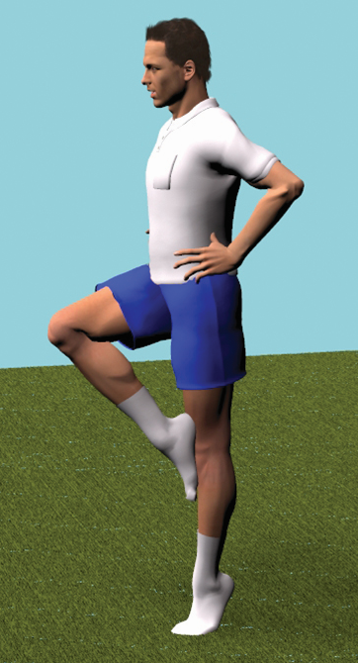
Stork Balance Test
Remove the shoes and place the hands on the hips, then position the non-supporting foot against the inside knee of the supporting leg.
The subject raises the heel to balance on the ball of the foot. The stopwatch is started as the heel is raised from the floor.
The stopwatch is stopped if any of the follow occur:
  the hand(s) come off the hips
  the supporting foot swivels or moves (hops) in any direction
  the non-supporting foot loses contact with the knee.
  the heel of the supporting foot touches the floor.

Slide 29
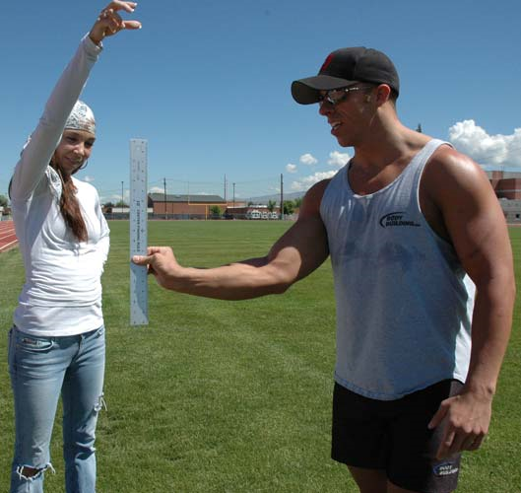
Reaction Time – Ruler Drop Test
The person to be tested stands or sits near the edge of a table, resting their elbow on the table so that their wrist extends over the side.
The assessor holds the ruler vertically in the air between the subject's thumb and index finger, but not touching.
Align the zero mark with the subjects fingers. The subject should indicate when they are ready.
Without warning, release the ruler and let it drop - the subject must catch it as quickly as possible as soon as they see it fall.
Record in meters the distance the ruler fell. Repeat several times (e.g. 10 times) and take the average score

Slide 30
Quick Quiz
Name the test used for assessing power. (1 mark)
How is a performer positioned at the start of the agility test? (1 mark)
Which component of fitness is assessed using the ruler drop test? (1 mark)
Over what period of time does the Cooper run take place? (1 mark)
State two factors which would in the stopwatch being stopped in the stork stand test. (2 marks)
Which piece of equipment is used to assess strength? (1 mark)

