Slide 1
Principles of training
Understand the terms Specificity, Progression, Overload, Reversibility and Tedium
Understand what plateauing is and how to avoid it

Slide 2
Principles of Training
The principles of training can be remembered using the Sport acronym...
Specificity
Progression
Overload
Reversibility
Tedium
They are how we ensure that our training is as effective as possible and avoids plateauing (progress seems to halt and takes time to move on)

Slide 3
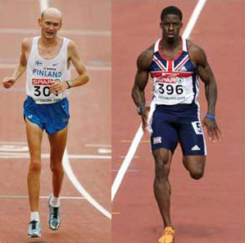
Specificity
The process of making sure that your training is particularly suited to a sport or activity
A marathon runner will need to ensure that their training is designed to improve their stamina (CV endurance)
whereas
A sprinter will need to ensure their training is speed and power focused
It is also necessary to consider the performer as an individual as people we react differently to the same method of training.

Slide 4
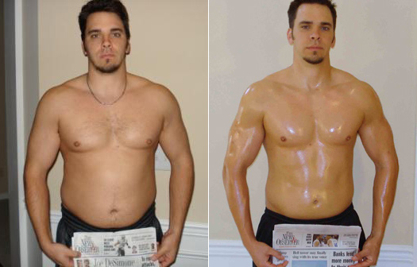
Progression
The intensity of training will increase gradually as the body becomes adjusted to the previous demands
As you train your body it will adapt to the demands it is being put under
Therefore it’s necessary to increase the demands for improvement to continue
Examples of progression
Bicep curling 12.5kg increasing to 15kg
Continuous run for 30 min increasing to 35 min
Sprint training at 90% max increasing to 95%

Slide 5
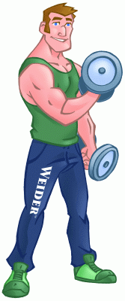
Overload
Making the body work harder than normal in order to improve it
There are different ways in which you can overload your body...
Frequency- Increasing the number of sessions
Intensity- Increasing the amount of activity in a session
Time- Increasing the duration of a session

Slide 6
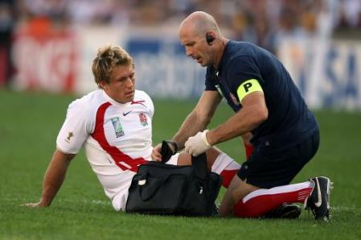
Reversibility
If training stops then the improvements that have been made will diminish (the opposite of progression)
Typically happens after an injury or having a break from training.
Pre-season training will be less intense than during the season.
It is thought that you need to train for 3 times the break to get back to where you were (e.g. 2 weeks out injured needs 6 weeks training to recover)

Slide 7
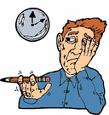
Tedium
Becoming bored with your training leading to reduced effort or simply avoiding it
Can be a major factor leading to plateauing
Varying the way you train can avoid this happening
Combination training can be used when more than one component of fitness is needed to be improved (Team Sports etc)

