Slide 1
Aspects of Training
Be aware of what should included within a training session
Understand training thresholds

Slide 2
Aspects of training
All training sessions should be made up of specific stages…
Warm Up
Fitness/ Exercise phase
Skill or team play phase
Cool Down

Slide 3
Warm-Up
All training sessions should start with a warm up…
It prepares the body for activity by increasing blood flow
It reduces the possibility of injury (usually muscle)
It encourages you to become psychologically prepared
A warm up will usually consist of distinct sections…
Pulse raising activity- Gentle movement to increase heart rate, breathing rate and body temperature.
Light Stretching- Gentle mobility stretches for whole body as well as specifically targeted towards main muscles which will be sued

Slide 4
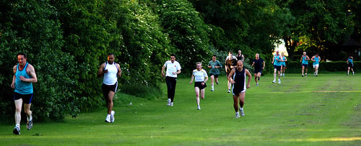
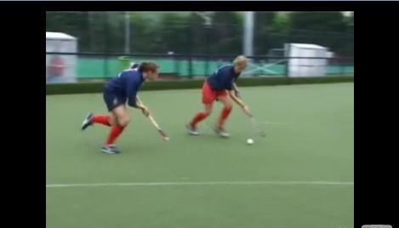
Fitness phase
Concentration on the aspect of fitness which you have identified to improve (SPECIFICITY)
Skill phase
When training for a team activity you would work together
Can also be done individually

Slide 5
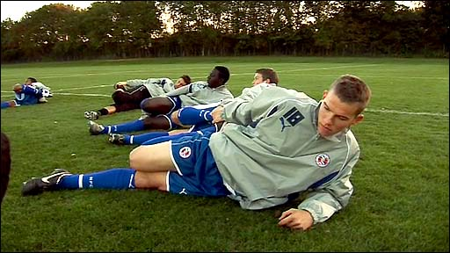
Warm Down
Rather than just stopping you end the session gradually…
Helps with recovery
Removes lactic acid (and other waste products)

Slide 6
Thresholds of training
Training must be designed to suit individual’s need…
To calculate how hard you are working (intensity) you need to find your Maximum Heart Rate = 220 - age
So for a 14 year old it would be
=220 – 14 = 206
This is linked to training thresholds…
Aerboic threshold = 60 – 80% of maximum heart rate
Anaerboic (Training) threshold = 80 – 90% of maximum heart rate

