Slide 1
Circuit training
Understand what types of circuit training can be used
Look at the benefit and limitations of using circuit training

Slide 2
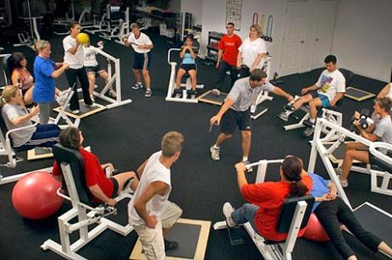
Circuit training
One of the most common forms of training…
Easy to set up
Very flexible

Slide 3
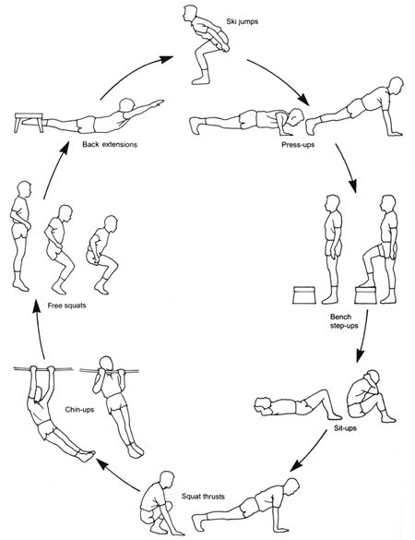
Setting up
Uses a variety of exercises known as stations
Usually between 6 and 12
Need to consider…
Clearly marked stations, ideally with a diagram
Station should be demonstrated beforehand
Similar station or those which work similar muscle groups should be spread out to avoid over-working
Recovery period should be built in.

Slide 4
Fitness Circuit
Primarily aimed at improving a specific component of fitness (Specificity)
Often used to improve Stamina as well as strength in certain muscle groups.
Typical activities include…
Press Ups
Squat Thrusts
Skipping
Tricep Dips
Star Jumps
Burpees
Trunk Curls
Shuttle runs
Sit ups
Main advantages of this type of circuit…
Little or no specialist equipment needed
Can be carried out in a standard sports hall

Slide 5
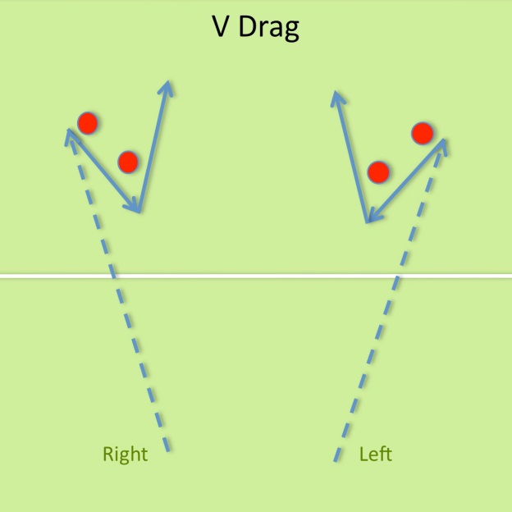
Skill Circuit
Will use stations but exercises will be focused upon improving a specific skill…
Good method of pre-season training as works stamina as well as developing skills
Examples could be looking at…
V drag in hockey
Passing in basketball
Dribbling in football

Slide 6
Running the circuit
Different method of running a circuit…
Timed circuits- set time for exercise followed by set periods of rest
Fixed Load- Station is labelled with exact amount of repetitions to do
Varied laps (sets)- Most circuits will have more than 1 lap, may vary the time of exercise or rest. Can add sprint laps with short exercise times and very little rest in between

