Slide 1
Weight training
Understand why weight training is used
Understand the terms repetitions and sets.

Slide 2
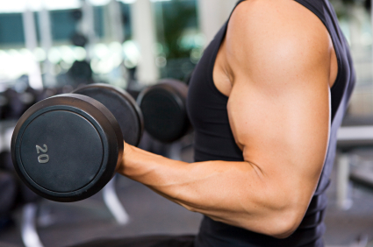
Weight Training
Primarily used to improve an aspect of muscular strength, could also include endurance and power.
Muscular strength
Increasing muscle size or bulk
Improving muscle tone
Assisting recovery and injury

Slide 3
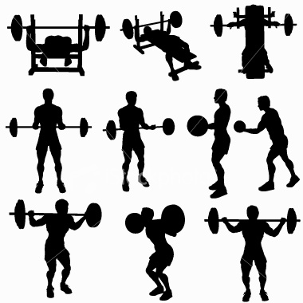
Organising an effective session
Rapid growth in weight training equipment and facilities
Due to some sort of strength being useful for almost all performers
To make it effective you apply the overload principle to put your muscles under stress so they are forced to adapt…
Repetitions- the number of times you actually move the weights
Sets- the number of times you carry out the activity

Slide 4
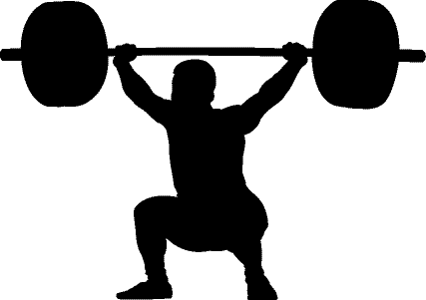
Using Reps and Sets
Will use in different ways depending on the aspect of strength you wish to improve…
Muscular strength
Near max weight
3 sets
6 reps
Muscular Endurance
40-60% max weight
At least 3 sets
20 – 30 reps
Power
60-80 max weight
At least 3 sets
10 - 15 reps

Slide 5
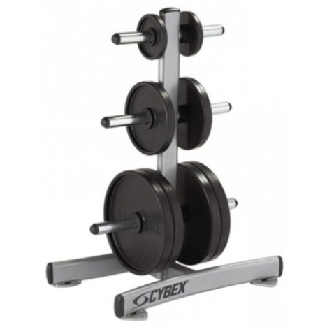
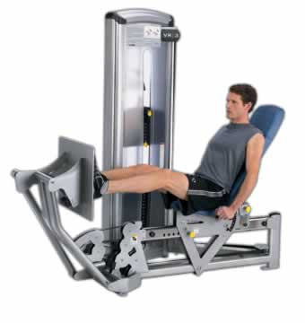
Types of weight training
Two main types depending on the weights you use…
Free Standing weights
Dumbbells, Barbells and bars
Adaptable weight
Can be purchased at home
Limited in safety as should have a training partner
Specialist weight-training equipment
Machines found in gyms, leisure centres etc.
Fixed weights within machine, changeable by moving pin
Safer to use as machines reduce chance of injury.

