Slide 1
Further Training methods
Continuous training
Interval training
Fartlek training

Slide 2
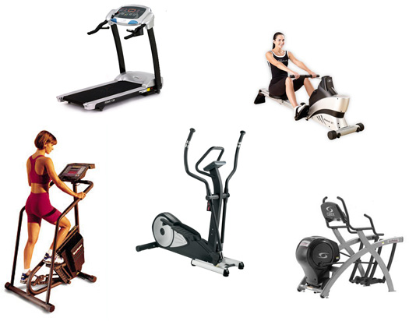
Continuous training
Any type of training where there is a prolonged period of exercise...
Running/jogging
Cycling
Swimming
Aerobics
The heart rate is kept consistently high to develop Stamina
Commonly done using cardio machines at the gym

Slide 3
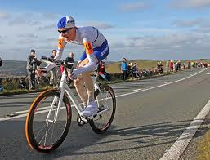
Interval training
Periods of work followed by periods of rest
Heart rate will move between...
Training Zone (80% - 90% of max) during exercise
Aerobic Zone (60% - 80% of max) during rest
Long Interval training
Work at 85% of max for anywhere between 15 seconds and 3 minutes
Similar amount of rest time
Short Interval training
Work at maximum levels for no more than 15 seconds
Extended rest time (up to 2 minutes)

Slide 4
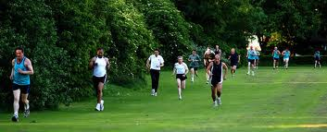
Fartlek training
Form of interval training involving different changes of speed
Walking
Brisk Walking
Jogging
Fast run
Sprint
So during your rest periods you will still be moving...
Keeps the pulse rate higher

Slide 5
Comparison of methods...
Method | Advantages | Disadvantages | Useful for...
Continuous | Doesn’t need specialist equipment Can be done anywhere | Tedium | Long distance events
Interval | Always involves rest period Can be done anywhere | Not as effective for higher levels of stamina | Games players, middle distance athletes, sprinters
Fartlek | Moving during rest periods increases intensity Very realistic for games players | Not as suitable for lower levels of stamina | Games players

