Slide 1
Balanced Diet
Understand what constitutes a ‘balanced diet’
Know the different food types
Consider problems that can arise from a poor diet

Slide 2
Balanced Diet
“A balanced diet contains all the nutrients that you need in the appropriate amounts”
How much of each you need depends on your…
Basic Metabolic Rate (BMR)
The amount of energy required to keep life processes going at rest
Physical activity level (PAL)
The amount of energy needed to fuel all of your physical activity
BMR + PAL = your daily energy requirement

Slide 3
Food Types
Carbohydrates
Used for: Fast release energy
Found in: Pasta, potatoes, cereals
Fats
Used for: Slow release energy
Found in: Oils, dairy products, nuts and fish
Protein
Used for: Growth and repair
Found in: Meat pulses and fish
Vitamins
Used for: Helps body work and concentration
Found in: Fresh fruit and vegetables
Simple = sugars Complex = starches
Minerals
Used for: Helping release energy and decision making
Found in: Fruit, vegetables and fish
Fibre
Used for: Aids digestive system
Found in: Fruit, vegetables, wholegrain cereals and wholemeal bread
Water
Used for: Avoiding dehydration

Slide 4
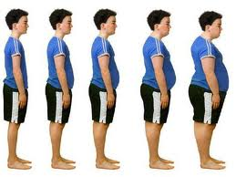
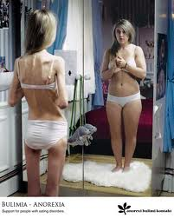
Dietary considerations
There is no single food which is able to provide you with all the nutrients, therefore it is important to eat a variety
How much of each?
Carbohydrates 60% Fats 25% Protein 15%
Failing to maintain a healthy diet…
Malnutrition- physical weakness resulting from insufficient food or an unbalanced diet
Obesity- eating more than is needed resulting in being overweight, frequently resulting in health problems
Anorexia- Eating disorder relating to fear of gaining weight through a distorted body image.

