Slide 1
Age differences
Consider the effects that ageing has on the body
How these effects might affect the suitability for certain activities
Understand the different

Slide 2
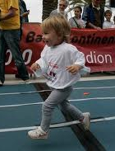
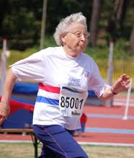
Age
Age is something which we have no control over
BUT
being aware of what effects it has is important

Slide 3
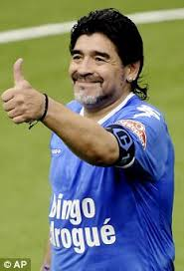
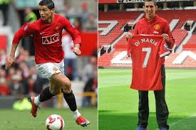
Physical age affects our physical maturity and this in turn affects our suitability for certain activities
List the physical differences for the below two age groups

Slide 4
RECOVERY
FLEXIBILITY
PHYSICAL AGE
EFFECTS
STRENGTH
SKILL LEVEL
OXYGEN
CAPACITY

Slide 5
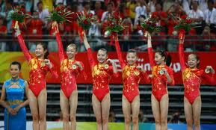
Flexibility
Very high in older children and teens
Name the sport?
Average age of Olympic champions is 17 years old
Gymnastics
Tends to decrease with age
Coupled with tendency to put on weight

Slide 6
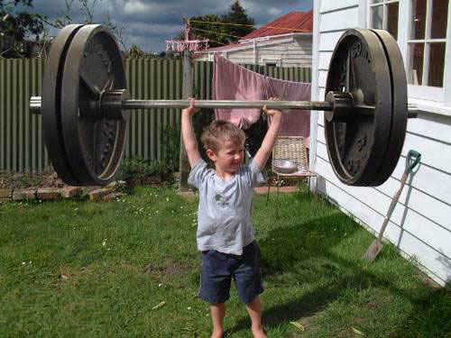
Strength
You won’t achieve maximum strength until fully grown
late teens to early twenties
This is why weight training is not recommended for youngsters
Strength will then decrease as you get older

Slide 7
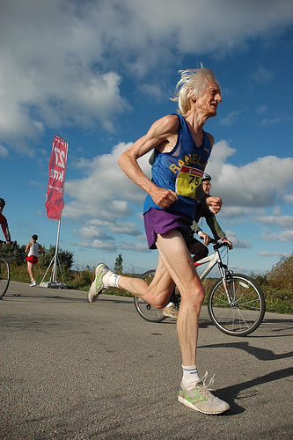
Oxygen capacity
Oxygen capacity reduces with age
Heart becomes less efficient
Arteries lose elasticity
Blood pressure increases
Blood flow reduces

Slide 8
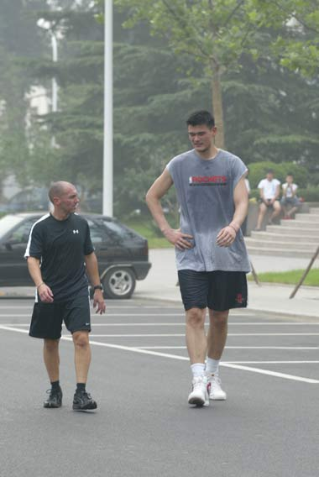
Skill Levels
Skill levels will improve with age and experience
Can be linked to physiological developments
Taller basketball players find shooting easier

Slide 9
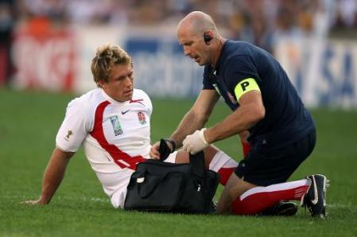
Recovery
As you get older…
Increased chance of injuries (wear and tear)
Longer you take to recover
Higher chance of diseases

Slide 10
Activity Sheet 7.2 Age and requirements for participation
Age affects the activities that we take part in, as the table below shows. Examine the table and consider:
What are the four most popular activities for the 16-19-year-old group?
What do you think are the requirements that might help a member of this age group to become active?
What are the four most popular activities for the 60-69-year-old group?
What do you think are the requirements that might help a member of this age group to become active?
Which activities have higher participation rates after the age of 24 than before?
Why do you think this is the case?
Percentage taking part in the 4 weeks before interview
Age | 16-19 | 20-24 | 25-29 | 30-44 | 45-59 | 60-69 | 70+
Overall | 77 | 69 | 70 | 67 | 59 | 50 | 30
Selected activities
Walking | 29 | 31 | 33 | 39 | 40 | 37 | 22
Swimming | 19 | 17 | 17 | 20 | 13 | 7 | 3
Keep Fit/Yoga | 15 | 16 | 19 | 16 | 11 | 7 | 4
Cycling | 18 | 12 | 12 | 13 | 8 | 4 | 2
Weight training | 11 | 13 | 12 | 8 | 3 | 1 | 0
Running/jogging | 11 | 9 | 11 | 8 | 3 | 1 | 0
Soccer | 24 | 13 | 11 | 6 | 1 | 0 | 0
Golf | 5 | 5 | 6 | 6 | 5 | 4 | 2
Tennis | 6 | 4 | 2 | 2 | 1 | 1 | 0
Badminton | 6 | 2 | 3 | 2 | 2 | 1 | 0
Bowls | 1 | 0 | 0 | 0 | 1 | 4 | 3
Squash | 2 | 2 | 3 | 2 | 1 | 0 | 0
Table tennis | 5 | 2 | 1 | 1 | 1 | 0 | 0

Slide 11
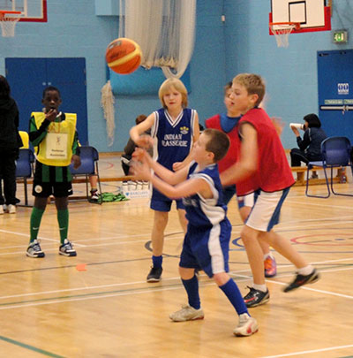
Age Divisions
School and youth level sport is normally organised into age divisions
Can be flexible with playing above age groups
Not everyone matures at the same level
Matural age doesn’t always match Chronological age

Slide 12
AGE DIVISIONS
Make a list of different age categories that exist across different activities
Are there any examples where athletes can perform above their age division and are their any sports this would not be appropriate and why?

