Slide 1
Environment, Challenge and Risk.
Understand how environment can affect participation
Consider the aspect of challenge in sport
Understand the importance of managing risks.

Slide 2
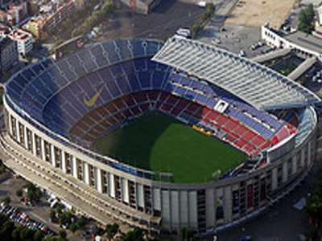
Environment
Environment is not based on a single factor…
Some elements you will have control over
Some elements you won’t have control over
All these factors can have an effect on participation levels

Slide 3
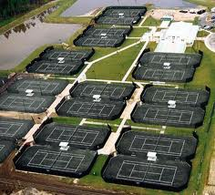
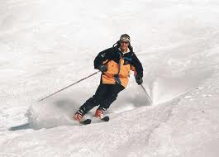
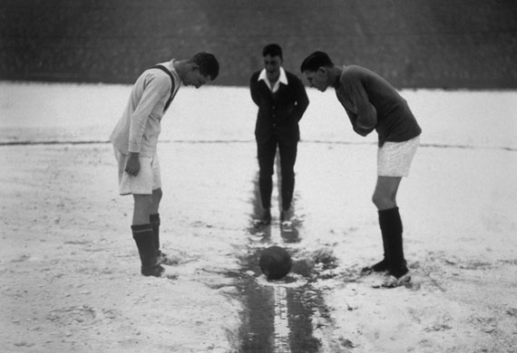
Weather
No control over the weather
Professional sportsman may be able to travel around the world
Finding appropriate training or competing conditions
Weather can affect both training for an event and taking part in it.

Slide 4
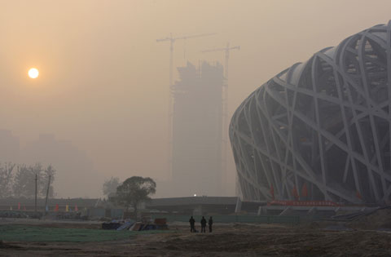
Pollution
Air Pollution can be a serious health risk for those competing
Can also affect ability to train
Olympics video

Slide 5
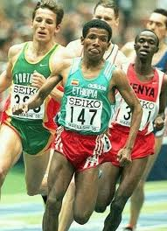
Altitude
Height of an area above sea level.
Training and performing at high altitude can be very beneficial (Covered later in year)
Living in areas of high altitude can give real advantage to endurance athletes.

Slide 6
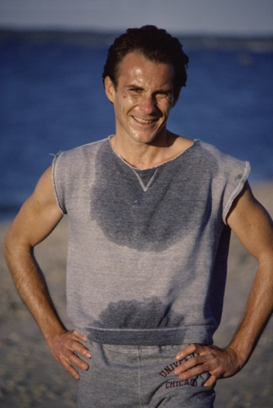
Humidity
The amount of water vapour in the air.
Humidity combined with heat makes competing very difficult
Unable to regulate body temperature
Leading to dehydration

Slide 7
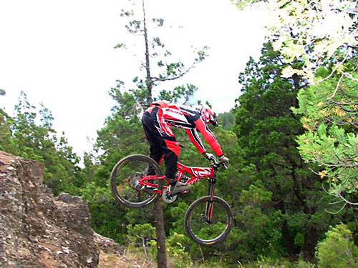
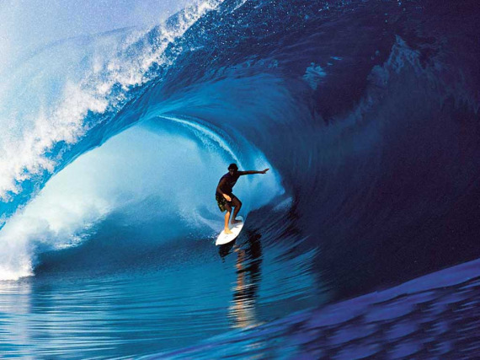
Terrain
Landscape affecting your ability to train and compete
Downhill bikers need access to hilly areas
Road cyclists need flat areas for speed trials
Skiers need access to slopes
Surfers need waves

Slide 8
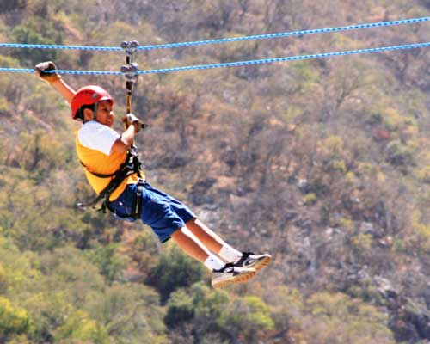
Challenge and Risk
Many people take part in activities which offer them…
A challenge and an acceptable amount of risk
Need the balance to be right in order for activity to be safe

Slide 9
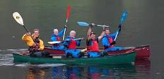
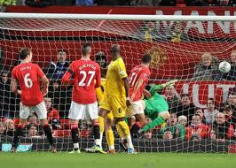
Challenging activities
Outdoor and adventurous activities
Taken part of in the natural environment
Clearly have many challenges attached to them
Climbing
Kayaking
Orienteering
Other activities
Challenge attached to difficulty
Tackling a bigger opponent in rugby
Bating a team form a higher league in the cup
Running a marathon

Slide 10
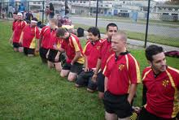
Risk
Risk assessment
Vital that potential hazards are spotted before activity is undertaken
Risk control
Means that all efforts have been made to ensure participants are safe.
Ensure equipment is appropriate
Football studs
Jewellery
Ensuring ages and genders are appropriately split (Juniors)
First Aider present
Soccer AM

