Slide 1
Activity Levels and training
Consider how demands of an activity affect an individual
Appreciate the benefits of high activity levels.
Consider the different factors which can affect a training schedule

Slide 2
Activity levels
Vary between individuals under the headings of…
Activity needs
Activity effects

Slide 3
Activity Needs
The needs will vary between activity as they will place varying demands on the performer…
Competitive activities
Highly committed- training to compete
Recreational activities
Not demanding
More than 1 training session a week (Skill and fitness)
Cricketer might have to give up a whole day for a game
If professional will concentrate on activity full time
Require no specific training
Taken part at a convenient time

Slide 4
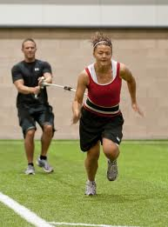
Activity effects
The level at which you train will have an effect on you…
High levels of participation bring many physiological benefits
These will only be maintained if high levels of participation continue
Principle of Reversibility
Other benefits include meeting like minded people and
gaining a sense of personal achievement
Physical
Mental
Social

Slide 5
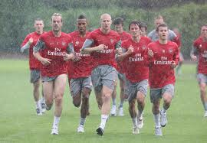
Training
This is a factor that you have almost total control over, you decide how much or how little you do.
Main factors affecting it will be…
Available time
In order to become better, time is needed to train…
Easy for a professional as they will have free time in which to do it
Amateurs have to fit it in around work and when facilities are available
Vicious circle
Available funds
Need to pay for better facilities or equipment
Performers often seek sponsorship to enable them to train more effectively

Slide 6
Periodisation
Specifically used by those performing at the highest level to gain the most benefits from training.
Ensures that they peak at the right time for the competition…
Pre-season
Initial preparation, concentrating on fitness and specific techniques
Peak Season
Main period to build to competitive performance
Post-season
Period of rest and recovery while keeping up general fitness

