Slide 1
Leisure and Recreation
Consider what is meant by leisure time and recreation
Consider the choices people make about their leisure time
Consider the benefits to becoming involved in active leisure

Slide 2
Leisure time
Leisure time is simply the time when you choose what you do
Free time when all other commitments have been fulfilled

Slide 3
Types of Leisure
Active Leisure
- Activities involving physical or mental exertion
- Low impact and non-competitive physical activities (Yoga or walking)
-Higher impact activities (Aerobics of kick boxing)
Passive leisure
- Activities with no physical exertion
- Large health concern in UK
- Activities such as playing computer games, going to the cinema or watching TV

Slide 4
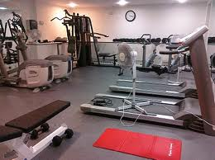
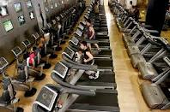
Leisure provision
Due to changes in working days we now have more leisure time than previous generations
Leisure industry is more competitive
Increased quantity or provision
Increased quality of provision
Local authorities have a legal responsibility to provide leisure services
Libraries, swimming pools, playing fields and sport centres
Private enterprises (companies) have increased quality of provision
However they aim to make money so not suitable for everyone
Location affects your leisure provision
Urban areas have more opportunities than rural areas

Slide 5
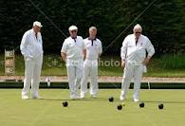
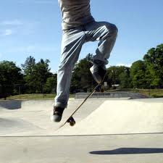
Recreation
Recreation can just mean to relax and enjoy yourself, increasing used to mean doing something which is active and healthy
Physical recreation is typically done for intrinsic reward rather than extrinsic reward
Enjoyment, pleasure, sense of achievement, adrenalin rush, stress relief
Which activity people chose to do depends on a number of factors…
Age – Some activities will be more suitable for different age groups
Elderly taking part in lawn bowls and younger people skateboarding
Location - Activities such as surfing near the coast or snowboarding near the snow
Provision and cost – No access to the activities in your area or too expensive
Specialist facilities such as snow domes or rock climbing walls

Slide 6
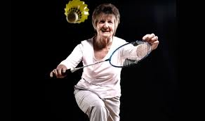
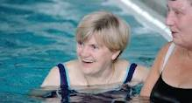
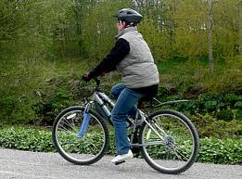
Lifelong sports
Finding an activity which you can carry on through life
Many organisations encourage this by having specific age group sessions

Slide 7
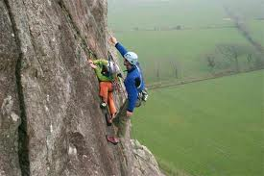
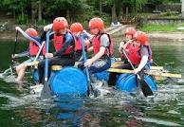
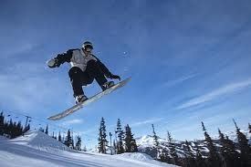
Outdoor recreation
Activities done in natural environment…
Usually involve an element of challenge
Overcoming the natural environment you are put it
Rock Climbing
Water based activities- Sailing, windsurfing etc
Skiing or snowboarding

