Slide 1
7.1 Media in sport
What are the main forms of media?
What influence does the media have?

Slide 2
Media in sport
There are four main ways in which the media can be involved in sport. These are:
The Press (Newspaper, Books, etc)
Television
Internet
Radio

Slide 3
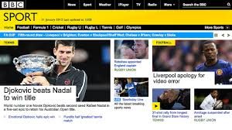
Internet
Constantly developing area becoming an increasingly popular way to watch live sport and see a range of sporting information.
Sport can be viewed on a range of different systems including mobile phones, laptops, tablets.

Slide 4
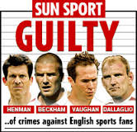
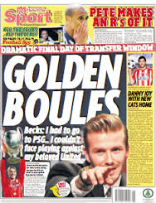
The Press
Cannot present live coverage
Text and still photos
Low production costs
Influenced by writers point of view
Often sensationalise sports stories to entice readers

Slide 5
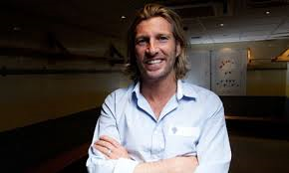
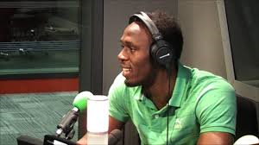
Radio
Much cheaper to produce than TV
Less influential as generally attracts less consumers than TV/internet.

Slide 6
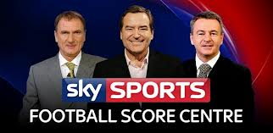
TV
Can provide live coverage
A leading way to show sport (although this is being challenged by online developments)
Can greatly enhance peoples knowledge of sport
Quality of coverage is constantly improving (replays, advanced analysis tools etc)
Broadcasting rights can involve huge sums of money (Premier league football) which can have a great influence on a sport
Pay per view for some events (some events protected by government from this such as FA cup final, Wimbledon, Grand National)

Slide 7
Types of Programme
Programmes come in 4 different categories:
Informative – e.g. results/tables, fixtures
Educational – e.g. debates/issues/highlights/minority sports
Instructive – e.g teaching/coaching
Entertaining – e.g. excitement/drama

Slide 8
Exam Question Describe two ways in which the director of a televised sports event could influence how sport will be seen by viewers. (4 marks)
• Selects highlights to be shown/ to make the game seem more exciting.
• Selects sports to be shown / from a range of options as in a multi-sport event like the Olympic Games
• can be a very positive influence as all of the action can be shown/ from fair and unbiased angles
• can also influence the commentators or summarisers, to be fair in their commentary/ which shows a balanced content of the game
• can decide not to show negative aspects so that this behaviour is not encouraged
• can have a negative influence as they may choose to show certain parts of the action or edit shows or programmes/ which can give a false impression of the actual events
• can choose to focus on poor attitudes or even poor behaviour by fans/ to sensationalise certain aspects and give a sport or an individual a bad name
• can have a positive influence by using effects such as action replays or different camera angles or microphones by the pitch or ref link/ which shows good play or decision making.
• Decides who to interview/to get further insight into the game, or event, or competition

Slide 9
Positive Effects of Media Coverage
Increases revenue through payments for broadcasting rights and sponsorship.
This can lead to multiple benefits including raising standards at elite level and increased opportunities at grass roots level.
Educates people about sports (rules, techniques, tactics, opportunities to take part etc)
Increases participation by raising awareness and interest.
Can create positive role models (and the opposite!)
Aids coaching – technological advances allow for greater analysis of performance.
Educates about the need for healthy lifestyle/ and shows the consequences of a sedentary lifestyle

Slide 10
Discuss with a partner how the media has had a positive influence on a sport of your choice. List as many positive effects as you can.

Slide 11
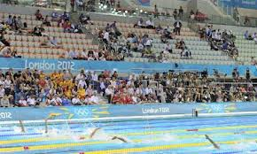
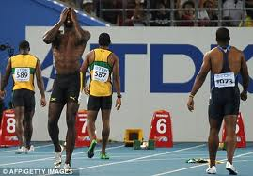
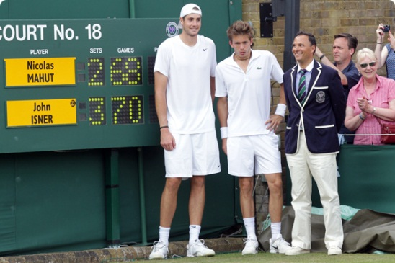
Negative influence of the media
Intrusion on an event
Limited privacy for competitors
Number of workers get in the way of spectators
Media pressure
Rules of competitions may be changed
Speed up or make more drama
Edited coverage
TV choose what to display, not all actions seen
Altered timings
Need to televise for the largest audience- often USA
Undermining officials
Slow motion replays highlight errors
Limited attendance
Provision on TV means some will stay away form event itself
Biased popularity
Events will become more and more popular with coverage

Slide 12
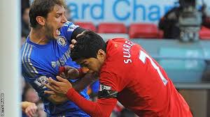
Negative influences of Media
Can publicise poor behaviour from spectators and performers (negative role models)
Can create a win-at-all-costs attitude / cheating / gamesmanship
Builds rivalries between teams

Slide 13
Discuss with a partner any negative effects that the media has had on a sport of your choice.

Slide 14
Exam Question
Explain how the media may have influenced a students’ participation in sport. (6 marks)
• Increased coverage on all forms of media encourages interest
• Media informs of opportunities and possibilities
• Media educates about the need for healthy lifestyle/ and shows the consequences of a sedentary lifestyle
• Informs how and where to participate
• Media can entertain and therefore attract participation
• Media can promote role models who you can then aspire to be like and achieve what they have.
Any other suitable answer.

