Slide 1
7.2 Sponsorship
How are sponsors involved in sport?
What types of sponsorship exist?
What are the advantages and disadvantages of sponsorship?
Sponsorship in Sport Clip

Slide 2
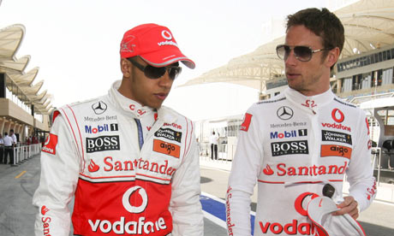
Individual sponsorship
More than ever people are negotiating individual deals
F1 drivers are covered in different sponsors
Tennis has strict rules on size and number of logos allowed in competition
People will be paid simply to wear/use products when competing
Obviously higher profile attract better deals
Can lead to endorsement deals and advertising campaigns

Slide 3
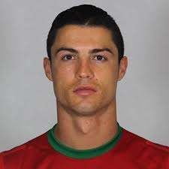
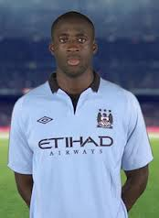
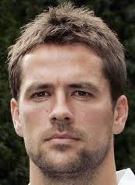
Name their sponsor?
Nike
Grays
Puma
Adidas and Head
Umbro
Woodworm

Slide 4
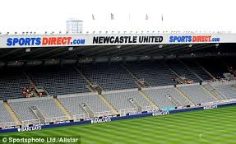
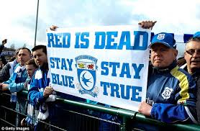
Teams and clubs
Kit sponsors are a huge part of sport
Even amateur club and school teams are likely to have a sponsor
Lucrative deals exist for kit, equipment, training facilities and stadiums
Increasingly seen in football with named stadiums…

Slide 5
Name the club?
Liverpool
Burnley
Aston Villa
Spurs
Stoke
Palace
Arsenal
Wigan

Slide 6
Sports and Events
Many sports have deals arranged with major sponsors to promote leagues or cup competitions
Football League cup- How many can you name???
Lesser known sports are likely to find it harder to obtain
Events are more popular than ever to have sponsors
London 2012- numerous sponsors
Certain one off event such as FLORA London marathon
1982–1986
Milk Cup
1986–1990
Littlewoods Challenge Cup
1990–1992
Rumbelows Cup
1992–1998
Coca-Cola Cup
1998–2003
Worthington Cup
2003–2012
Carling Cup
2012–2016
Capital One Cup

Slide 7
Types of Sponsorship
Vary greatly to individuals, teams or sports
Equipment - eg balls/ higher quality/ enables advanced skills to be developed.
Clothing - eg team kit/ which boosts confidence or morale/ so that they work better as a team.
Footwear - improves grip/ to stop them from slipping.
Transport and travel - enter more competitions a greater distance away/ to play a greater variety of teams.
Money - to employ a coach/ to develop advanced skills.
Facilities - train more often/ to develop fitness.
Entry fees or league fees - enter more competitions/ play at a higher level.

Slide 8
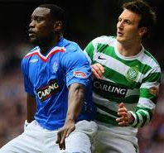
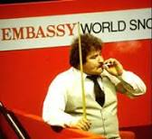
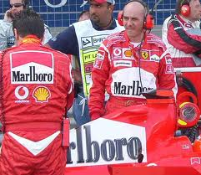
Unacceptable sponsorship
Associated with products which are deemed inappropriate
Where there is a lack of a healthy link
Encouraging something life threatening
Tobacco has been banned from sponsoring sporting events
Alcohol is still seen but particularly activities where young people are associated
Alcohol sponsorship

Slide 9
Discuss with a partner the advantages and disadvantages of sponsorship for:
A- the individual / team / sport
and….
B- the sponsor
Can you identify at least 2 advantages and disadvantages for each?

Slide 10
Advantages/disadvantages of Sponsorship for the individual/team/sport
Advantages | Disadvantages
Reduces financial pressures and allows for full time training | Exploitation to suit sponsors needs (e.g. must use their equipment)
Funding to allow entry into competitions | Sponsor may dictate rule changes or changes to timings of a sport
Provision of coaching, equipment, travel, specialist facilities | Support can be withdrawn if individual is unsuccessful
Increased income and superstar salary status | Some sports will lose out and therefore have reduced funding (e.g. table tennis v football
Can raise the profile of a sport | Bad image presented if sponsored by tobacco, alcohol etc.

Slide 11
Advantages/disadvantages of Sponsorship for the Sponsor
Advantages | Disadvantages
Success, health, popularity of sports star etc are all associated with the sponsor | Always a risk as success in sport is never guaranteed
Media coverage is a great advertising outlet | Media coverage could be reduced or stop and so few would see the advertising
Logos and brand names become well known and recognised | Wrong image may be presented with hooliganism of fans at an event or poor behaviour of individuals/teams
Payments made are often tax deductible

Slide 12
Exam Question State two different types of sponsorship and explain how each could help a netball team to improve the players’ performance. (6 marks)
Award one mark for each different type of sponsorship and up to two further marks for an explanation of how each could help to improve the players’ performance (2x3).
Equipment eg balls/ higher quality/ enables advanced skills to be developed.
Clothing eg team kit/ which boosts confidence or morale/ so that they work better as a team.
Footwear/ improves grip/ to stop them from slipping.
Transport and travel/ enter more competitions a greater distance away/ to play a greater variety of teams.
Money/ to employ a coach/ to develop advanced skills.
Facilities/ train more often/ to develop fitness.
Entry fees or league fees/ enter more competitions/ play at a higher level.

