Slide 1
7.3 Role Models
What characteristics might a role model have?
What significance do role models have on sport?

Slide 2
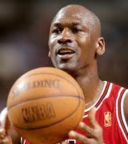
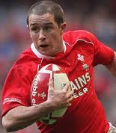
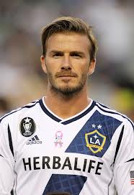
Sporting role-models
Sport creates role models who can be extremely influential, especially on young people.
Michael Jordan
Shane Williams
David Beckham

Slide 3
Exam Question What is meant by a ‘role model’? (2 marks)
A role model is somebody who other people aspire to be like
Who they look up to or idolise
Who set an example for others to follow.

Slide 4
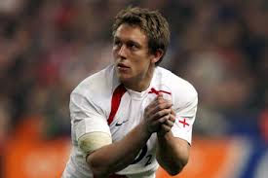
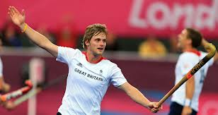
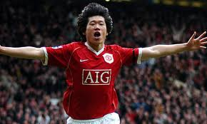
Common characteristics
Since they are looked up to by young people they will be expected to show certain characteristics…
Competing or playing by the rules
Being Inspirational
Being a high profile performer (Elite level?)
Setting trends for others to follow
Conducting themselves well in their private life as well as sporting life
Being accessible- Media coverage or someone closer to home (Coach?)
Taking part in a popular activity
Representing a particular group

Slide 5
Pressure on Role models
Media pressure and lack of privacy.
Possible targeting by other performers to damage their image.
Being sought after and then dropped by companies.
Being expected to be available to promote and increase participation.
Pressure of their status affecting their performance.
Difficulty of coping with unexpected fame and coping with it.

Slide 6
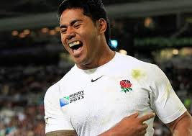
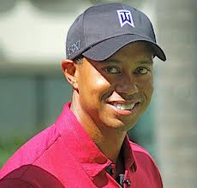
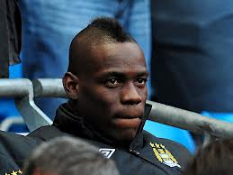
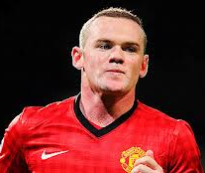
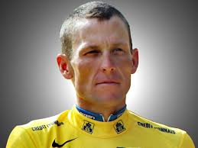
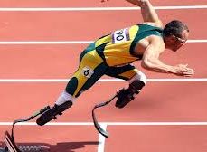
Are they a role model?

Slide 7
Your task…
Who is your role model? (It doesn’t have to be an elite performer)
Why do they inspire you?
What is it about them that you relate to?

Slide 8
Exam Question Explain how an elite gymnast could have had an effect on a 16 yr-old amateurs’ level of participation or performance in gymnastics. (4 marks)
Participation
• By watching elite gymnast perform/ amateur is more motivated or inspired/ to train more / or compete in more competitions
Performance
• Elite performers success/ may have encouraged amateur to train harder/ to achieve a similar standard/ because he enjoyed watching his performance/ amateur may have copied his technique.

