Slide 1
7.4 Health, Safety and Equipment
What are general health and safety guidelines?
What sport specific safety rules exist?

Slide 2
Health and Safety
What factors do you think we need to consider when thinking about health and safety in sport?
Risk assessment
Rules
Physical preparation
Environment
Techniques / skills
Footwear
Clothing
Equipment

Slide 3
Risk Assessment
The aim of a risk assessment is to identify and minimise risk
Risk Assessment Template
Potential Hazard | Who is at risk | Existing control measures | Risk rating | Preventative measures

Slide 4
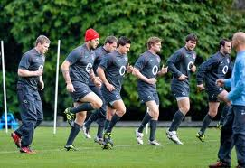
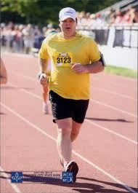
Physical Preparation
A gradual aerobic warm up ensures that muscles are warm to prevent injury.
A cool down helps prevent muscle soreness.
Performers must be physically prepared for an event in terms of skill and fitness levels. Inadequate preparation is likely to lead to injury.
E.g. Training before a marathon
Learning to tackle correctly in rugby
Sunday league football tackle

Slide 5
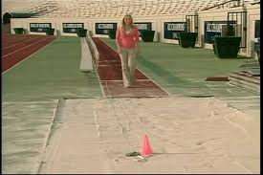
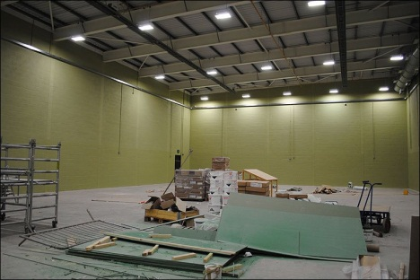
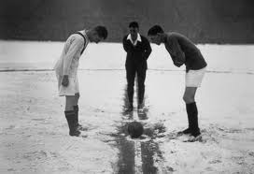
Environment
Assessing the environment is important to ensure playing area is safe
No glass or sharp objects
Long jump pit
Indoor Surface slippery?
Wet?
Floor area clear of debris?
Extreme weather conditions?
Snow
Thunder storms
Prolonged dry spells

Slide 6
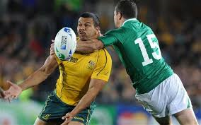
Rules
All participants must know and understand the rules.
Failure to follow the rules is likely to result in injury or health issues
E.g.
Incorrect studs in football
High tackle in rugby
Wearing jewellery in netball
Taking performance enhancing drugs

Slide 7
Exam Question Using an example, explain how following the rules can make participation in a physical activity safer. (2 marks)
Award up to one mark for an example of a rule and a further mark for why it makes participation in a physical activity safer.
• Wearing shin pads in football or hockey/ to prevent damage to the shins in a tackle.
• No foul play, eg no two footed tackle/ to prevent injury.
Accept any other suitable response.

Slide 8
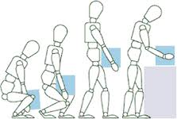
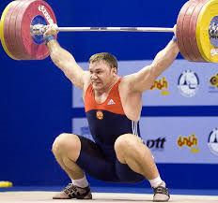
Manual Handling
When lifting…
Bend with your knees
Not your back
Keep object close to your body
Repeat when lowering

Slide 9
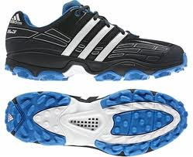
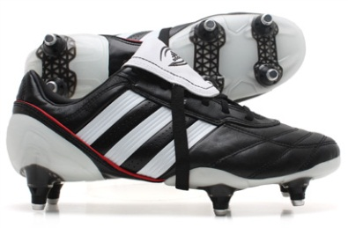
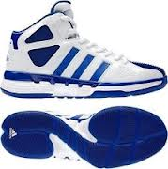
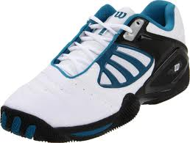
Clothing and Footwear
Trampolining
Avoid wearing loose clothing
Outdoor pursuits
Dependant upon weather conditions
Waterproof clothing, Insulated clothing and/or Suitable footwear
Athletics
Spiked shoes used on track- varying types
Gymnastics and Dance
Bare feet or some prefer light shoes
Games
Specialist shoes depending on surface
Astroturf for hockey
Boots for grass
Basketball needs more ankle support
Lighter trainers for tennis

Slide 10
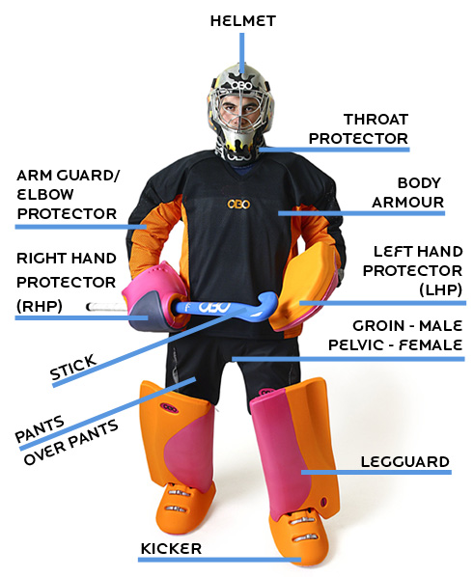
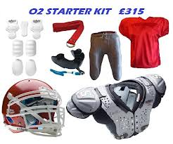
Sport specific equipment Games won’t start without correct equipment worn

Slide 11
Clothing, Footwear and Equipment
For a sport of your choice list as many different points as you can regarding which clothing, footwear and equipment is required for your sport. Include why each item is important in terms of performance and injury prevention.

