Slide 1
7.4 Science and ICT in sport
How have technological advances improved sport?
How is ICT used in sport?
What impact does ICT have upon sport?

Slide 2
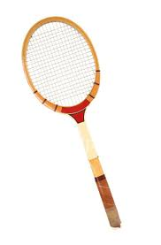
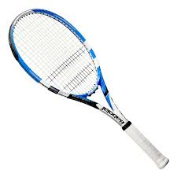
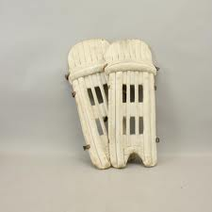
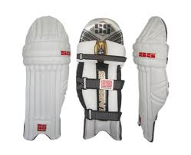
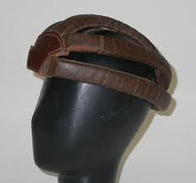
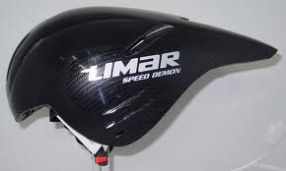
Equipment
Development of new materials means equipment is lighter, stronger and more durable than before.
Improvements in equipment lead to improvements in performance and safety.
Tennis Rackets
Hockey sticks
Cricket Pads
Cycling Helmet
Technological advancements in sport

Slide 3
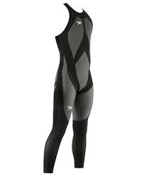
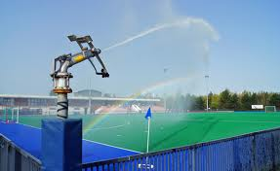
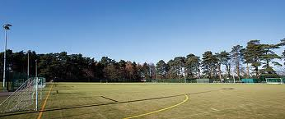
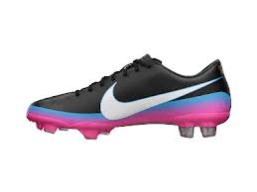
Materials
Development of synthetic materials have revolutionised sportswear…
Swimming
Full body suit developed
Increased streamlining (reducing drag)
Surfaces
Surfaces have been hugely improved
Development of AstroTurf- different types
Footwear
Making using of lighter weight materials
Stronger and more flexible

Slide 4
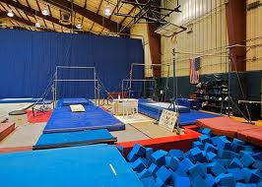
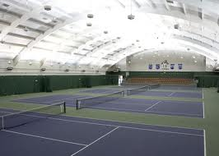
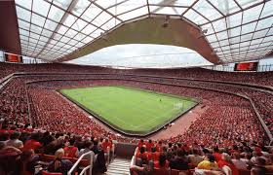
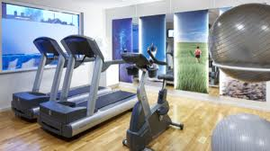
Facilities
Gymnastics
Now have purpose built facilities
Tennis Clubs
Specifically designed indoor areas
Stadiums
Retractable roof, air conditioning
Gyms
State of the art equipment

Slide 5
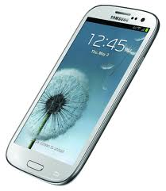
Data Storage
Using a computer (Desktop, Laptop, Tablet or phone) means data can be stored
Many different people make use of this…
GCSE PE students
PE departments
Professional sports teams

Slide 6
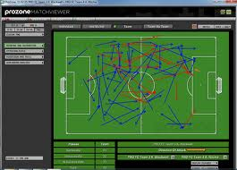
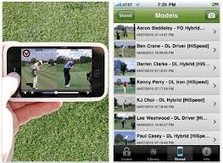
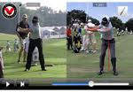
Performance Analysis
Huge increase in recent years- in line with technological improvement
Dartfish programme
Déjà vu function
Prozone
Video recordings
In recent years apps have changed this topic dramatically…
Ubersense

Slide 7
Benefits of Improved ICT for Sports Performance
• Digital cameras allow performance to be monitored, reviewed and modified.
• Improved data storage allows performance to be reviewed over a period of time to see if improvements have been made.
• Performer can review previous performances and mentally rehearse to facilitate performance.
• Computer software (Dartfish, Kandle, Ubersense) can be used to analyse performance to identify weaknesses that can then be worked on.
• Sound recordings can be played to simulate crowd noises during training to replicate atmosphere.
• Fitness monitoring equipment can monitor pulse rates, energy expenditure etc resulting in improved performance through detailed monitoring of training and competition.
• Use of the internet to display recorded performances which can be commented on by others which could lead to improvements.
• Advanced communication technology has improved knowledge of coaching and training methods, which raises performance levels.

Slide 8
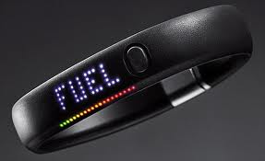
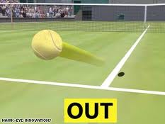
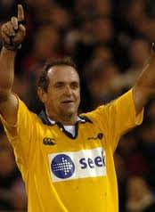
Performance aids
Fitness monitoring- measuring heart rate, blood pressure and working within training zones
Hawk-eye – Helping with decision making in certain sports by tracking motion.
Video officials- Used in sports to support the decision of the official.

Slide 9
Exam Question
Using examples, explain how technological developments could help Ben (an amateur gymnast) to improve his performance in gymnastics. (8 marks)

Slide 10
Answer
Facilities
• Sprung floors allow Ben’s routines to become more difficult due to the extra height that can be gained.
• Facilities for training have developed to include improved foam landing areas enabling Ben to practise more difficult moves.
Equipment
• Improved quality of equipment (eg springboards) allows Ben’s performance to increase due to more difficult moves to be performed.
• Development of a vaulting platform with a greater surface area allows more complex moves to be performed.
ICT/Video Analysis
• Digital cameras and videos to obtain feedback from a performance so this can be monitored and reviewed so performance can be modified.
• By cataloguing performance overtime on a computer Ben can be shown how his performances have improved.
• By videoing performance this can be sent to Ben so he can visualise and mentally rehearse routines to facilitate performance.
• Computer software (Dartfish or Kandle) that can be used to analyse Ben’s performance to identify weaknesses that can then be worked on.
• Sound recording played to simulate crowd when Ben is training, to replicate atmosphere or add to stress levels.
• Fitness monitoring equipment can monitor Ben’s pulse rates, energy expenditure resulting in improved performance through detailed monitoring of training and competition.
• Use of the internet to display Ben’s recorded performances which can be commented on by others which could lead to improvements.
• Advanced communication technology has improved knowledge of coaching and training methods, which could raise Ben’s performance levels.
Clothing
• The introduction of new materials has allowed tight fitting clothing to be developed. This allows a greater range of movement and therefore the opportunity for Ben to gain higher marks.

