Slide 1
Diet
Learning Objectives:
To be able to name and describe the 7 components of a healthy diet.
To understand the dietary needs of sports performers.

Slide 2
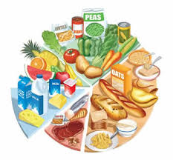
Components of a Healthy Balanced Diet
Carbohydrates
Fats
Proteins
Vitamins
Minerals
Fibre (roughage)
Water (fluids)

Slide 3
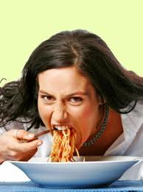
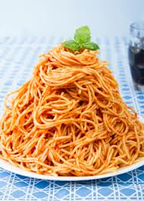
Carbohydrates
The main source of energy and thus essential for sports performers.
Simple carbohydrates (sugars) such as glucose provide quick energy release.
Complex carbohydrates (starches) such as pasta, bread and potatoes need to be broken down into glucose and so provide slow energy release.

Slide 4
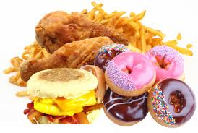
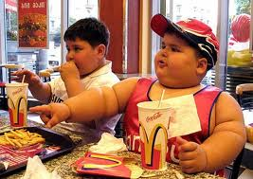
Fats
A source of slow release energy.
An important component of a diet when consumed in moderation.
Excess fat can have negative effects on sports performance.
Can be saturated (bad) and unsaturated (good).
Found in food such as cream, meat, butter and cooking oil.

Slide 5
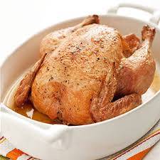
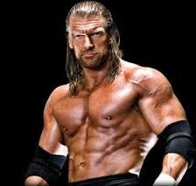
Proteins
Essential for growth and repair of the bodies cells and tissues (such as muscle).
Required for building muscle and recovering from training.
Found in foods such as chicken, meat, eggs, nuts.
Mo Farah advert

Slide 6
Vitamins
Required in small amounts for a variety of functions essential for healthy living.
E.g. Oranges for vitamin C to support immune system.
Minerals
Required in small amounts for variety of functions. Mainly found in meat and vegetables.
E.g. milk contains calcium essential for strong bones and teeth; broccoli contains iron essential for red blood cell production.

Slide 7
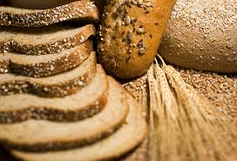
Fibre / Roughage
Essential for a healthy digestive system.
Found in cereals, wholegrain and oats.

Slide 8
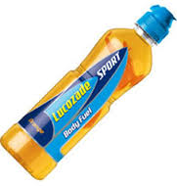
Water
Essential for functioning of all cells of the body.
Loss of water results in dehydration.
This has huge negative effects on sports performance.
Important for athletes to take on water regularly to replace fluids lost in sweat.

Slide 9
Dietary Considerations
There are 5 main food groups:
Bread, rice, potatoes, pasta and other starchy food
Fruit and vegetables
Milk and dairy foods
Meat, fish, eggs, beans and non-dairy protein
Food and drink high in fat and/or sugar
The proportions for these foods as part of a healthy diet are shown in the following diagram…..

Slide 10
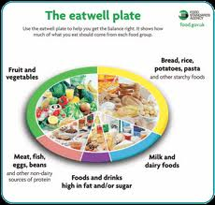

Slide 11
Unhealthy Diet
Failure to follow a healthy balanced diet can lead to:
Malnutrition – physical weakness resulting from insufficient food or unbalanced diet.
Obesity – a condition of being extremely fat or overweight. Measured in various ways including BMI score and skin callipers. Leads to numerous health issues (heart disease etc).
Anorexia – an eating disorder related to fear of weight gain and a distorted body image.

Slide 12
Athletes Diet
Athletes have a higher basal metabolic rate (energy required for the body to function) and therefore need a greater amount carbohydrates (and fats) in their diet.
Calorie intake must be higher to equal calories being used to produce energy.
If calorie intake is higher than calories used then weight is gained and vice versa.

Slide 13
When to eat
Before activity – important not to eat too close to activity (causes sickness). Eat 2 hours before.
During activity – only to be done in small amounts to provide an energy boost.
After activity – leave a 2 hour gap before replacing lost carbohydrates taking on protein to aid recovery.
Liquids should be consumed regularly but in small amounts.

Slide 14
Carbohydrate Loading
A method for increasing carbohydrate stores used by endurance athletes, particularly marathon runners.
Involves consumption of high carb diet in the days leading up to the event.
Increases the stores of glycogen in the muscles (the form of stored glucose).

Slide 15
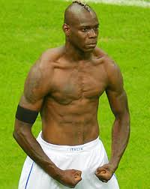
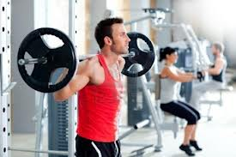
High Protein Diets
Often used by bodybuilders to gain muscle and lose fat.
This only works alongside an appropriate training programme.

