Slide 1
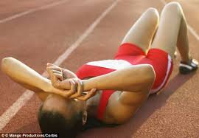
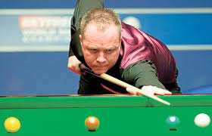
Fatigue and Stress
Learning Objectives
To understand what fatigue and stress are.
To be able to explain the factors which lead to these.
To understand the effects that they can have on a performer, both physically and mentally.

Slide 2
Fatigue
A feeling of extreme physical or mental tiredness brought on by extreme exertion.
The following factors are associated with fatigue:
Local muscle fatigue – a muscle or group of muscles is unable to carry on contracting and movement stops.
Concentration levels decrease and mistakes of judgement are common.
Skill levels decrease as speed and strength decrease.
The performer must rest or stop the activity. If not then injury can occur.
Marathon runners hitting the wall

Slide 3
Stress
The body’s reaction to a change that requires physical, mental or emotional adjustment or response.
Excitement or suspense can lead to tension. This could include physical muscle tension.
Anxiety can lead to apprehension and mistakes. Some performers thrive in these situations.
Nervousness can add to tension results in physical shaking or feelings of sickness.
Andy Murray nerves v Djokovic wimbledon final (50secs onwards)

