Slide 1
Physical Education GCSE Revision
EDEXCEL

Slide 2
Healthy, active lifestyle
A lifestyle that contributes positively and negatively to physical, mental and social well being and includes regular exercise and physical activity.
WHAT MAKES UP A HEALTHY ACTIVE LIFESTYLE?
Taking part in physical activity, eating a balanced diet and avoiding harmful substances such as drugs/alcohol
PHYSICAL ACTIVITY- any form of exercise or movement .
HEALTH- state of complete mental, physical and social well being and not merely in the absence of disease or infirmity.
COMPETENCE- the relationship between skill tactics and strategies .
FITNESS- the ability to meet the demands of the environment
PERFOMANCE- how well a task is completed

Slide 3
SOCIAL BENEFITS
PHYSICAL BENEFITS
MAKE FRIENDS
COMPETITION
CO-OPERATION
MAINTAIN HEALTH
IMPROVE BODY SHAPE
CONTROL WEIGHT
INCREASE FITNESS
STRONGER BONES/MUSLCES
IMPROVE POSTURE
MENTAL BENEFITS
KEEPS YOU HAPPY
RELIEVE STRESS/TENSIONS
INCREASE CONFIDENCE
CHALLENGE
INCREASE SELF-ESTEEM
AESTHETIC APPRECIATION- how good an activity looks
SEROTONIN- is released during activity improving a person’s energy and mood

Slide 4
HEALTH RELATED FITNESS
Cardiovascular Fitness (cooper 12minute run/bleep test)
The ability to exercise the entire body for a long period of time
Muscular Endurance (abdominal curl test)
The ability to use voluntary muscles many times without tiring
Flexibility (sit and reach)
The range of movement possible at a joint
Muscular Strength (hand grip test)
The amount of force muscles can exert against a resistance
Body Composition (skin fold test)
Percentage of body made up of fat muscle and bone

Slide 5
SKILL RELATED FITNESS
Agility (Illinois agility run)
The ability to change the position of the body quickly and with control
Balance (stalk stand)
The ability to maintain the body’s centre of mass above the bass of support
Coordination (alternate ball toss)
The ability to use two or more body parts together
Power (standing vertical jump/standing broad jump)
The ability to execute strength performances quickly
Reaction Time (the ruler drop)
The time between the onset of a stimulus and the onset of a movement
Speed (30m sprint)
The differential rate at which an individual is able to perform a movement or cover a distance in a period of time

Slide 6
PRINCIPLES OF TRAINING
Specificity- matching training to the requirements of an activity
Progressive overload- to gradually increase the amount of overload so that fitness gains occurs without potential for injury . ‘overload’- working harder than normal
Individual needs- matching training to the requirements of an individual regarding their age/sex/gender/ability/ current fitness
Rest and recovery- REST is the period of time given to recovery, RECOVERY is the time required for the repair of damage to the body caused by training or competition
Frequency- how often
Intensity- how hard
Time- how long
Type- what
Reversibility- any adaptation that takes place as a result of training will be reversed when you stop training. If you take a break or don’t train often enough you will lose fitness.
Par-Q test- a doctors questionnaire to see whether you are able to participate in sport.

Slide 7
AEROBIC AND ANAEROBIC TRAINING
training will make both systems work harder but the type of training needed for each is different:
AEROBIC- with oxygen (marathon runner) Aerobic fitness is achieved through prolonged low intensity training which allows ‘recovery’ for the removal of lactic acid. AEROBIC FITNESS HELPS DEVELOP STAMINA
ANAEROBIC- without oxygen (sprinter) Anaerobic fitness is achieved through high intensity training which can only be carried out in short bursts of activity. ANAEROBIC FITNESS HELPS DEVELOP SPEED

Slide 8
HEART RATE AND TRAINING THRESHOLDS
our heart rate gives us the best clue as to what system (aerobic or anaerobic) we are using when exercising:
THE HARDER YOU EXERCISE THE FASTER YOUIR HEART BEATS
~~~~~~~~~~~~~~~~~~~~~~~~~~~~~~~~~~~~~~~~~~~~~~~~~~~~~~~~~~~~~~~~~~~~~~ YOUR HEART RATE IS A GOOD INDICATOR OF WHICH ENERGY SYSTEM IS BEING USED
~~~~~~~~~~~~~~~~~~~~~~~~~~~~~~~~~~~~~~~~~~~~~~~~~~~~~~~~~~~~~~~~~~~~~~ THE CLOSER IT IS TO YOUR MAXIMUM HEART RATETHE MORE LIKELY YOU ARE TO BE USING YOUR ANAEROBIC SYSTEM
~~~~~~~~~~~~~~~~~~~~~~~~~~~~~~~~~~~~~~~~~~~~~~~~~~~~~~~~~~~~~~~~~~~~~~ MAXIMUM HEART RATE IS THE FASTEST YOUR HEART CAN BEAT SAFELY FOR A LONG PERIOD OF EXERCISING

Slide 9
HEART RATE AND TRAINING THRESHOLDS
Maximum heart rates: maximum heart rate = 220 – age E.G. my maximum heart rate = 220 – 16 = 204bpm (beats per minute)
using heart rate thresholds is a good way of keeping a check on how hard you are working and what energy system you are using: AEROBIC TRAINING ZONE ANAEROBIC TRAINING ZONE =220 – AGE =220 – AGE 60% - 80% OF ANSWER 80% - 95% OF ANSWER (0.6 x ANSWER) – (0.8 x ANSWER) (0.8 x ANSWER) – (0.95 x ANSWER)

Slide 10
METHODS OF TRAINING
Circuit
Continuous
Cross
Fartlek
Interval
Weight

Slide 11
CIRCUIT TRAINING
This method of training involves performing a series of exercises in a special order called a circuit. Each activity takes place at a 'station'. It can be designed to improve speed, agility, coordination, balance and muscular endurance.
CONTINUOUS TRAINING
This method of training involves working for a sustained period of time without rest. It improves cardio-vascular fitness.

Slide 12
CROSS TRAINING
This method of training involves using another sport or activity to improve your fitness. It happens when an athlete trains in a different environment. For example a volleyball player uses the power training for that sport to help with fitness for long jump.
FARTLEK TRAINING
This method of training also known as 'speed play' involves varying your speed and the type of terrain over which you run, walk, cycle or ski. It improves aerobic and anaerobic fitness.

Slide 13
INTERVAL TRAINING
This method of training involves alternating between periods of hard exercise and rest. It improves speed and muscular endurance.
WEIGHT TRAINING
This method of training uses weights to provide resistance to the muscles. It improves muscular strength (high weight, low reps), muscular endurance (low weight, high reps, many sets) and power (medium weight and reps performed quickly).

Slide 14
INFLUENCES ON PARTICIPATION
IMAGE INFLUENCES (MEDIA/FASHION)
CULTURAL UNFLUENCES (RACE/AGE/GENDER/SEX/DISABILITY)
SOCIO-ECONOMIC INFLUENCES (MONEY)
RESOURCE INFLUENCES (FACILITIES/LOCATION)
INFLUENCIAL PEOPLE (SPORTS STARS/PARENTS/TEACHERS/PEERS)

Slide 15
INFLUENCES ON PARTICIPATION
IMAGE INFLURNCES
FASHION
MEDIA
Internet –BBC SPORT
Press –ATHLETICS WEEKLY –THE SUN
Radio- 5LIVE –5LIVE SPORTS EXTRA
TV- SKY SPORTS
TERRESTRIAL TV POSTIVIES
Keeps people informed
Encourages participation
NEGATIVES
More pressure on sport stars
Discourages watching live sport
SATALITE TV
POSITIVES
Wider variety of sports
Increases sporting funds
NEGATIVES
Days and times of matches change to fit with network

Slide 16
INFLUENCES ON PARTICIPATION
CULTURAL INFLUENCES
AGE- different age groups do different sports, older people might do golf/fishing whereas younger people are more likely to participate in a wider range.
DISABILITY- people with a disability can only usually participate in sports which have the facilities available for the disabled person to participate. ‘SPORT FOR ALL’ campaign encourages everyone to participate in sport.
GENDER- girls and boys sometimes have different interests in the sports they want to do, boys are more likely to do football/rugby whereas girls are more likely to do netball/dancing. But this isn’t always the case.
RACE- black people are more likely to be 100m runners, white people are more likely to be swimmers.

Slide 17
OPPORTUNITIES FOR GETTING INVOLVED IN SPORT
1. Government Initiatives policy that entitles all pupils to receive two hours of high quality physical education (PE) per week
2. PE School Sport and Club Links (PESSCL) the government set up the PESSCL strategy to increase the take up of sporting opportunities by 5-16 year olds (PE, School Sport and Club Links strategy)
3. The organisation Sport England start- increase participation in sport in order to improve the health of the nation stay- retain people in sport through clubs, sports facilities, coaches. succeed- create opportunities for talented performers to achieve success
4. The Youth Sport Trust TOP Link (sports leaders)
5. Active Kids programme various supermarkets run voucher programmes where vouchers collected by parents can be used by schools to buy sporting equipment, e.g. top links
6. Gifted and talented
The recognition of gifted and talented students to be pushed on to higher coaching opportunities

Slide 18
SPORTS PARTICIPATION PYRAMID
Foundation: may not understand all the rules at the stage and developing basic skills - SCHOOL SPORTS
Participation: young people begin to participate regularly in a specific activity for enjoyment - CLUB/TEAM
Performance: people begin to concentrate on specific skills and to develop skills in these sports - COUNTY/REGIONAL LEVEL
Elite: peak of the pyramid where individuals reach sporting excellence - NATION/INTERNATIONAL LEVEL
The number of people participating gets smaller at each increasing level.

Slide 19
ROLES IN SPORT
Role | Benefit to you | Benefit to others
Performer | Pleasure, success | Pleasure to watch, success
Official | Improve your knowledge of the rules. Can still contribute when unable to play. | Allows teachers to teach rather than umpire/referee
Coach | Improved self-confidence, gain a qualification | Improve their performance
Observer | Pleasure, improve knowledge. | Encouragement
Captain | Develop leadership skills | Encouragement, help the coach
Leader | Gain qualification, improve self worth | Provide role model, encourage participation
Organiser | Develop organisational skills, stay involved in sport if not able to participate | Enable sport to happen and arrange competitions etc
Choreographer | Outlet for creativity, develop ideas beyond your own ability | Provide exciting and challenging context for dancers

Slide 20
GOAL SETTING
SHORT AND LONG TERM GOALS short term goals: these are often set in training programmes and can act as incentives to train harder. They can work as a signpost indicating whether the performer is on target for success
e.g.
Win a race at the weekend
Get a personal best
long term goals: these targets are often the result of several training programmes and can sometimes lead to a competition or final event
e.g.
Training for an Olympics
Win the football league
Getting selected for county
OUTCOME GOALS- linked to the results of performance in a competition
PERFORMANCE GOALS- goals concerned with previous performance

Slide 21
SMART TARGETS
GOAL SETTING
Specific goals which are to the point for example a time or distance goal for an athlete
Measurable so it will be easy to know when the target has been achieved
Achievable goals that are challenging but reachable
Realistic goals should be realistic to the level of skill and fitness of the performer
Time bound so its within a certain time e.g. ‘I’d like to run under 12seconds in 100m by the end of July’

Slide 22
FOOD AND DIET
As with all people athletes will need to ensure their daily calorie intake supports all their energy requirements.
HIGH PROTEIN DIETS- this will help the person increase muscle and develop greater strength
HIGH CARBOHYDRATE DIET- this will help the person increase energy levels and so develop greater stamina
COMMON DIETING HABITS WHICH IMPROVE PERFORMANCE
It is important to eat + drink the correct foods in order to perform well. 1) BEFORE COMPETING
top sports people will ‘carbo load’ a few days before competiting to increase glycogen levels.
2) WHILE COMPETITING
very little if anything should be eaten while competing as the digestive system will not be able to deal with this and therefore the food will remain in stomach. however it is vital to replace water, so drinking is essential.
3) AFTER COMPETING
drink water to replace lost fluids and small amounts of food can be eaten
BLOOD SHUNTING at the beginning of exercise blood is ‘shunted’ to the working muscles leaving less blood for digestion. REDISTRIBUTION OF BLOOD DURING EXERCISE

Slide 23
FOOD AND DIET
MACRO NUTRIENTS
Carbohydrates: carbo loading, provides energy - pasta - bananas - potatoes - bread and rice
Fats: provides energy and with glycogen helps muscles to work - butter/ margarine - cooking oils
Protein: help builds muscles and repair damage tissue - meat/ poultry/ fish - milk/ eggs

Slide 24
FOOD AND DIET
MICRO NUTRIENTS
Minerals: are essential for a healthy body - calcium (milk, cheese, cereals) - iron (many foods however meat is absorbed easily
Vitamins: essential to health and they are necessary for good vision, good skin, healing, bones and teeth - VA (milk, cheese, yolk) - VB (grains, nuts, meat) - VC (fruit and vegetables) - VD (milk, fish, liver, eggs) - VE (vegetable oil, break, cereal)
Fibre adds bulk to food and helps with the digestive system - wholegrain cereal / bread

Slide 25
WEIGHT-RELATED CONDITIONS
Obesity: a term used to describe people who are very overfat, caused by eating too much and doing very little exercise. -puts extra strain on heart/muscles/bones/ligaments
-lead to joint and back injuries, heart attacks and strokes and an early death
-makes participating in exercise very challenging
Anorexic: a condition which results in the body being SEVERLY UNDERWEIGHT, a prolonged eating disorder due to loss of appetite.
-body feels weak and tired/poor immune system
-after a while can cause major organs to stop working resulting in death
Overfat: having body fat in the excess of normal
Overweight: having weight in excess of normal (not harmful unless accompanied by overfat)
Underweight: weighing less than is normal, healthy or injured

Slide 26
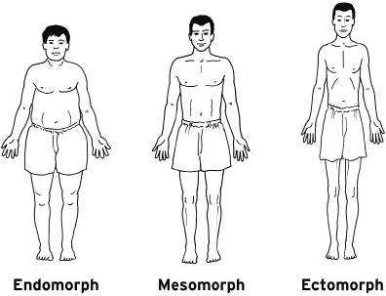
BODY TYPES

Slide 27
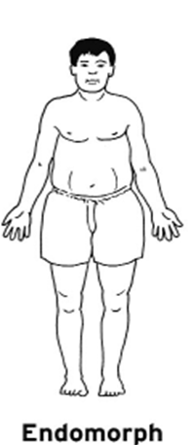
BODY TYPES
ENDOMORPHS
These people are often grouped in sports that depend on power. The individuals have wide hips and narrow shoulders, and are characterised by fatness.
E.g. - sumo wrestler

Slide 28
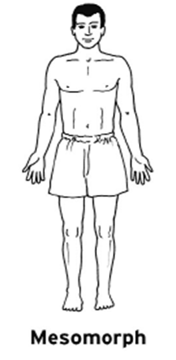
BODY TYPES
MESOMORPH
These people tend to be involved with sports which require strength and sudden bursts of energy. The individuals have wide shoulders and narrow hips, characterised by muscle
E.g. - sprinter

Slide 29
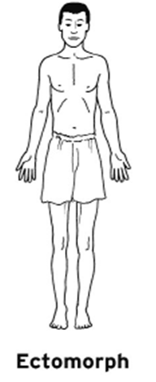
BODY TYPES
ECTOMORPH
The individuals with narrow shoulders and narrow hips, characterised by thinness.
E.g. - long distance runner

Slide 30
OPTIMUM WEIGHT
Optimum weight:
-best weight or desirable weight -the best weight a player performs at
Factors affecting optimum weight:
- height - gender
- bone structure
- muscle girth
- genetics

Slide 31
DRUGS
PERFORMANCE-ENCHANCING DRUGS
Narcotics/analgesics drugs that can be used to reduce pain - loss of concentration - loss of balance/coordination - emotional effects including hallucinations (morphine)
Stimulants drugs that can have an effect on the central nervous system, such as increased mental and/or physical alertness - high blood pressure - irritability - insomnia - irregular heart beat/ increased heart rate - addiction - some stimulants such as amphetamines, are highly addictive
Peptide hormones, including erythopoietin drugs that cause other hormones to be produces EPO increased the production of red blood cells, increases aerobic capacity -increases the risk of a heart attack or stroke because EPO thickens the blood, which makes it much more difficult for blood to pass through the small capillaries

Slide 32
DRUGS
PERFORMANCE-ENCHANCING DRUGS
Anabolic steroids: (sprinters) drugs that mimic the male sex hormone testosterone and promote bone and muscle growth - increased risk of heart attacks/strokes - high blood pressure - infertility in woman
Beta blockers: (snooker, archery) drugs that are used to control the heart rate and have a calming and relaxing effect - nausea and diarrhoea - tiredness - depression
Diuretics: drugs that elevate the rate of urine production - dehydration - long-term effects such as kidney problems
Blood doping: used to improve oxygen carrying capacity of the body 1) blood is removed from body 2) body automatically replaces lost blood 3) just before competition blood is returned back MORE BLOOD = MORE OXYGEN -capillaries can become blocked -kidneys have to work harder to clean the extra blood -cardiovascular system may become overloaded and not work properly

Slide 33
DRUGS
RECREATIONAL DRUGS
Alcohol - affects coordination, speech and judgement - slows your reactions - makes muscles tired more quickly - eventually damages your liver, kidneys, heart, muscles, brains and the digestive and immune system
Smoking - causes nose, throat and chest irritations - makes you short of breath - causes changes to your cardiovascular and respiratory system, which increases the risk of developing heart disease, lung cancer and other diseases

Slide 34
BONES
THE FUNCTION OF THE SKELETON
The skeleton is made up of bones which are held together at joints by strong ‘straps’ called ligaments. There are four main functions of the skeleton:
1. Movement: Where bones meet they form joints, which act as levers. Tendons attach the bones to muscles, enabling a variety of movements both fine and coarse.
2. Support: The skeleton supports the body in a variety of positions - standing up, sitting, lying down. The bones and skeletal system give the body shape. The skeleton acts as a framework from the body and also affects body composition and frame size.
3. Protection: Another function of the skeleton is protection. The cranium (skull) protects the brain. The spine, or vertebral column, protects the spinal chord. The ribs which form the chest protect the heart and lungs.
4. Blood production
Red and white blood cells are made in red bone marrow which is found at the end of the femur and humours and in the ribs, sternum, pelvis and vertebrae.
Connective tissues join muscle and bones: 1. CARTILAGE: forms cushions between bones to stop them rubbing 2. LIGAMENTS: like very strong string that holds bones together 3. TENDONS: attach muscles to bones (or other muscles)

Slide 35
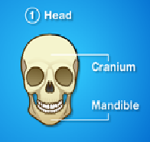
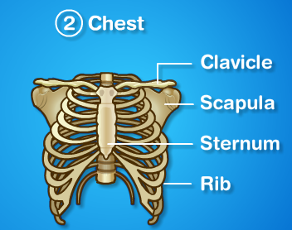
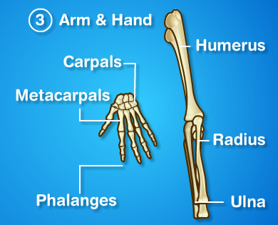
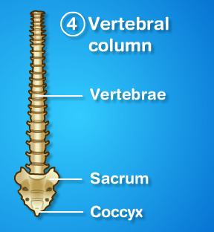
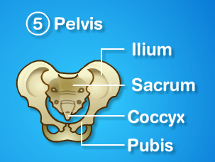
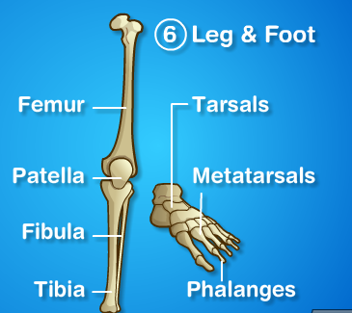
BONES

Slide 36
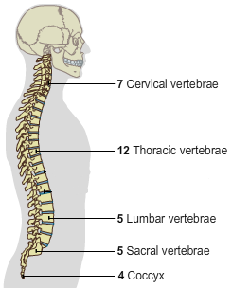
BONES
The Vertebral Column Charlotte The Lion Scares Children
It is made up of 34 vertebrae which are divided into 5 regions, each having its own function.
supports the head
MOVEMENT
the joints in the spine allow bending and twisting
SUPPORT
the spine is long and strong to support other body parts, e.g. the head
PROTECTION
the spine is hard and protects the nerves running through the middle, i.e. the spinal cord
ribs connected to these
these allow twisting and bending
fused to pelvis
these are remains of the tail

Slide 37
BONES
TYPES OF BONES
LONG TUBULAR BONES (FEMUR + HUMERUS) These are long and affect our overall height. They are not solid but contain marrow in the centre, this allows them to be strong but not too heavy.
SHORT BONES (CARPALS + TARPSALS)
They’re smaller and spongy with an outer layer of compact bone. They’re light and strong which is good for the movements required at the wrists and ankles.
FLAT BONES (CRANIUM + RIBS)
These are flat and are often found forming a protective surface.
IRREGULAR BONES (VERTERBRAE + FACE) These are irregular in shape and have a specific function.

Slide 38
BONES
Bones start to grow inside the womb, where they begin as cartilage
As you get older this turns into hard bone by a process called ‘ossification’
Bones will only grow properly as long as certain minerals and vitamins are eaten: -Vitamin D helps build bones -Calcium helps keep bones strong
A poor diet will result in soft bones, whilst a balanced diet and exercise will make bones harder

Slide 39
JOINTS
FIBROUS- Immovable joints, hold bones together
CARTILAGINOUS- Slightly moveable, each of the bones rests on a cushion of cartilage
SYNOVIAL JOINTS- freely moveable joints

Slide 40
JOINTS
SYNOVIAL JOINTS- FREELY MOVEABLE JOINTS
HINGE JOINTS: e.g. the elbow joint/the knee joint The joint can go backwards and forwards but not side-to-side -this allows flexion and extension
BALL AND SOCKET JOINTS: e.g. the shoulder joint The joint can move in all directions and it can rotate as well -this allows flexion, extension, adduction, abduction and rotation
CONDYLOID JOINTS: e.g. the wrist The joint can go forwards, backwards and sideways, but not rotation -this allows flexion, extension, adduction, abduction
GLIDING JOINT: e.g. between the tarsals or carpals Bones move a little bit in all directions by sliding over each other -this allows flexion, extension, adduction, abduction and rotation
PIVOT JOINT: e.g. the neck The joint can only rotate -this allows rotation

Slide 41
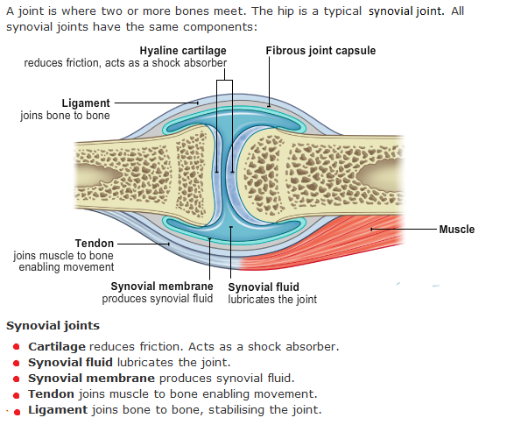
JOINTS

Slide 42
JOINTS AND MOVEMENT
A joint is a place where two or more bones meet. In order to prevent pain through the friction which might be caused by the bones rubbing together, the ends of the bones in a synovial joint are covered with a layer of thick cartilage known as hyaline cartilage.
Movements at joints: all joins allow movements but the extent and freedom varies from joint to joint, there are five to learn: flexion, extension, adduction, abduction and rotation.
1. if the angle of the joint is getting smaller then the movement is flexion
2. if the angle at the joint is getting bigger then the movement is extension
3. if the movement is taking away from the body then the movement is abduction
4. if the action is adding to the body then the movement is adduction
5. if the movement is around then the movement is rotation

Slide 43
MUSCLES
The body's involuntary muscles work our internal organs. They are outside our control. (e.g. digestion)
The body’s voluntary muscles make the body move. They are attached to the skeleton and can be controlled.
The cardic muscle contracts automatically at regular intervals.
MUSCLE SPEED Voluntary muscles have either fast or slow twitch fibres:
FAST TWITCH SLOW TWITCH
Contraction strength… very powerful Contraction strength… weaker Energy production… anaerobic respiration Energy production… aerobic respiration
Endurance… short periods of time Endurance… long periods of time
For who?... sprinters/discus throwers For who?... marathon runners

Slide 44
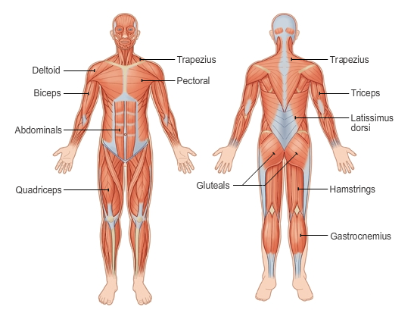
MUSCLES
INVOLUNTARY MUSCLES

Slide 45
MUSCLES
NAME OF MUSCLE | FUNCTION
TRICEPS | Extend the arm at the elbow
BICEPS | Flex the arm at the shoulder
DELTOIDS | Move the arm in all directions at the elbow
PECTORALS | Adduct the arm at the shoulder
TRAPEZIUS | Hold the shoulder in place and move head back and sideways
GLUTEALS | Adduct and extend leg at the hips
QUADRICEPS | Extend the leg at the knee
HAMSTRINGS | Flex the leg at the knee
GASTROCNEMIUS | Pointing the toes, help to flex the knee
LATISSIMUS DORSI | Adduct and extend the arm at the shoulder
ABDOMINALS | Flex the trunk across the stomach

Slide 46
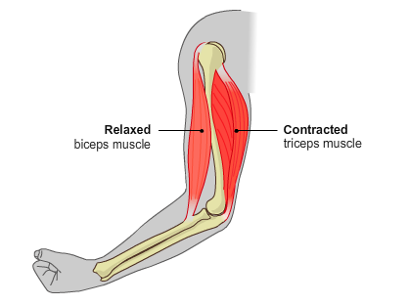
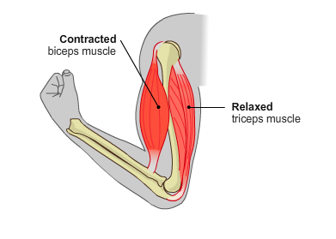
MUSCLES
ANTAGONISTIC MUSCLES
Skeletal muscles work across a joint and are attached to the bones by strong cords known as tendons.
Antagonistic pairs of muscles create movement when one (the prime mover or agonist) contracts and the other (the antagonist) relaxes. Examples of antagonistic pairs working are:
the quadriceps and hamstrings in the leg
the biceps and triceps in the arm
SYNERGIST- other muscles supporting the prime mover
Prime mover/agonist
Antagonist
Prime mover/agonist
Antagonist
The points at which the tendons are attached to the bone are known as the origin and insertion.
The origin is where the tendon of the muscle joins the stationary bone(s).
The insertion is where the tendons of the muscles joins the moving bone(s).

Slide 47
MUSCLE
TYPES OF MUSCLE CONTRACTION When a muscle contracts it does so in two main ways: isometric contraction or isotonic contraction
ISOMETRICS CONTRACTION
the muscle stays the same length as it works
there is no movement
ISOTONIC CONTRACTION
the muscle changes length as it works either lengthening or shortening
shortening is called a concentric contraction
lengthening is called an eccentric contraction
MUSCLE TONE
Even when muscle is relaxed a small number of its fibres are contracted. This stae of partial contraction is called muscles tone.

Slide 48
LONG-TERM EFFECTS OF EXERCISE (MUSCULAR AND SKELETAL SYSTEM)
muscles become thicker and stronger
bones become stronger
ligaments and tendons get stronger
Joints are more supple
Cartilage thinkens

Slide 49
IMMEDIATE EFFECTS OF EXERCISE
Breathing rate increases
Heart rate increases
Sweat production increases
Tidal volume increases.
Oxygen uptake increases.
Stroke volume increases.

Slide 50
LONG-TERM EFFECTS OF EXERCISE
Resting heart rate is lowered.
Cardiac output increases.
General fitness improves.
Muscles hypertrophy.
Recovery rate decreases.

Slide 51
THE RESPIRATORY SYSTEM
The purpose of the respiratory system is to: ‘bring the air we breathe into close contact with the blood so that oxygen can be absorbed and carbon dioxide removed’.
It consists of:
a pair of lungs connected to the mouth via the trachea and bronchi
the ribs and intercostal muscles of the chest which protect the lungs, trachea and bronchi

Slide 52
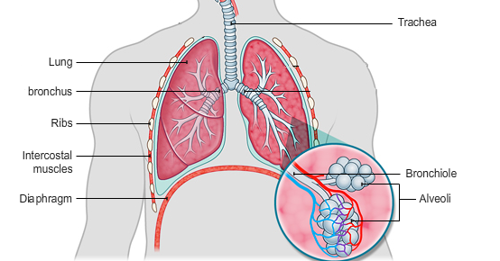
THE RESPIRATORY SYSTEM
Air enters the body through the nasal passage and mouth, and passes via the pharynx and larynx to the trachea
The trachea or windpipe is about 10cm long and is supported by c-shaped rings of cartilage to prevent the tube from collapsing during breathing
The trachea subdivides into the left and right bronchus. The bronchi are also strengthened by cartilage
Air is delivered to the alveoli as the trachea branches into bronchi and bronchioles
The two bronchi subdivides to form an extensive network of bronchioles that deliver air to the gas exchange surfaces the alveoli

Slide 53
THE RESPIRATORY SYSTEM
The lungs are in the thoracic cavity and are also protected by 12 pairs of ribs that join with the vertebrae towards the back of the body. The sternum (breastbone) is at the front of the ribcage.
The portions of the ribs that join with the breastbone are made of cartilage rather than bone.
Cartilage is softer and more pliable than bone and this helps the movement of the ribcage during breathing.
Sets of antagonistic muscles are found between the ribs- the intercostal muscle

Slide 54
THE RESPIRATORY SYSTEM
INHALING AND EXHALING When inhaling…
the intercostal muscles contract, expanding the ribcage.
the diaphragm contracts, pulling downwards to increase the volume of the chest.
pressure inside the chest is lowered and air is sucked into the lungs.
When exhaling…
the intercostal muscles relax, the ribcage drops inwards and downwards
the diaphragm relaxes, moving back upwards, decreasing the volume of the chest.
pressure inside the chest increases and air is forced out.

Slide 55
THE REPIRATORY SYSTEM
Inhaled air contains:
more oxygen used to create energy
less carbon dioxide than…
Exhaled air which contains:
more carbon dioxide produced as a waste product of energy production
less oxygen as it has been used in respiration
Gas exchange takes place by diffusion in the alveoli within the lungs. As a result the composition of inhaled and exhaled air is different.
GAS | % IN INHALED AIR | % IN EXHALED AIR
OXYGEN | 20.95 | 16
CARBON DIOXIDE | 0.04 | 4
NITROGEN | 79 | 79
WATER VAPOUR | 0.01 | 1

Slide 56
THE RESPIRATORY SYSTEM
HOW THE ALVEOLI AND CAPILLARIES WORK:
Air containing oxygen enters the lungs and passes into each alveolus from outside. Oxygen is diffused into the blood from the alveoli, the blood becomes deoxygenated.
Deoxygenated blood containing carbon dioxide comes from the rest of the body.
Air containing more carbon dioxide leaves the lungs.
The deoxygenated blood leaves the lungs and is transported by the circulatory system for use throughout the body.

Slide 57
THE RESPIRATORY SYSTEM
TIDAL VOLUME- the volume of air you breath in and out with each breath
RESPIRATION RATE- the number of times you breath in one minute
MINUTE VOLUME- the total volume of air breathed in and out in one minute
RESPIRATION RATE X TIDAL VOLUME = MINUTE VOLUME
VITAL CAPACITY- the maximum amount of air you can breathe out after breathing in as much as you can
RESIDUAL VOLUME- the air left in the lungs after you have breathed out as hard as possible
VO2 MAX- the amount of oxygen your body can take in and use in one minute

Slide 58
SHORT-TERM EFFECTS OF EXERCISE (RESPIRATORY SYSTEM)
Breathing is quicker
Breathing get deeper
Diffusion in the lungs increases
Respiration rate goes up

Slide 59
LONG-TERM EFFECTS OF EXERCISE (RESPIRATORY SYSTEM)
Greater cappiliarisation of the alveoli
Increased lung capacity
Can cope better with lactic acid
Lungs have a greater vital capacity
More alveoli in the lungs
Diffusion in the lungs increases

Slide 60
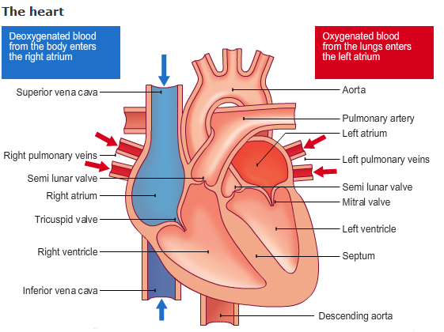
THE CIRCULATORY SYSTEM
The circulatory/cadiovascular system consists of:
BLOOD
BLOOD VESSELS -veins -arteries -capillaries
THE HEART

Slide 61
THE CIRCULATORY SYSTEM
BLOOD VESSELES
ARTERIES: Arteries carry blood away from the heart and have a thick elastic muscular wall which expands to carry the blood and only carries oxygenated blood apart from in the pulmonary artery, thick walls, small passageway.
VEINS: Thinner walls than arteries but they are wider channelled the blood is under a lower pressure than in the arteries, it also non-elastic and it carries deoxygenated blood except for the pulmonary vein.
CAPPILLARIES:
Capillary walls are one cell thick. Exchange of nutrients and respiratory gases occurs across their surface.

Slide 62
THE CIRCULATORY SYSTEM
Blood consists of…
Red blood cells - gives blood its colour, contains hemoglobin (which carries O2 from lungs to body)
White blood cells- deal with infection and disease by producing antibodies or engulfing germs
Platelets - made in bone marrow, produce clots when a blood vessel is damaged
Plasma - makes the blood sticky and stops you from bleeding to death

Slide 63
THE CIRCULATORY SYSTEM
The Blood’s purpose…
Transportation- carries nutrients from digestive system to body cells, takes oxygen to the muscles, removes waste, carries hormones
Protection- carries white blood cells to sites of infection, carries antibodies to destroy germs, carries platelets to damaged areas
Temperature regulation- maintains temp within body by carrying heat away from working muscles to skin and carrying heat from centre of body to skin
Maintains body balance- reduces effect of lactic acid, regulates fluid balance enables hormones and enzymes to work.

Slide 64
THE CIRCULATORY SYSTEM
Pulmonary Circuit
Pulmonary arteries carry deoxygenated blood from the heart to the lungs which then sends oxygenated blood along the pulmonary veins back to the heart.
Systematic Circuit
Systematic veins send oxygenated blood around the whole body. When the oxygen has been used by body cells, deoxygenated blood is sent back to the heart along the systematic arteries. SYSTEMatic circuit- whole body, whole SYSTEM

Slide 65
THE CIRCULATORY SYSTEM
BLOOD PRESSURE
SYSTOLIC BLOOD PRESSURE rises during activity as more blood is needed by the body
DIASTOLIC BLOOD PRESSURE blood pressure falls during the diastolic phrase as this is the resting stage, the pressure depends mainly upon the elasticity of the vessels

Slide 66
SHORT-TERM EFFECTS OF EXERCISE (CIRCULATORY SYSTEM)
Blood pressure increases
Heart rate goes up
Breathing rate increases
Stroke volume increases

Slide 67
LONG-TERM EFFECTS OF EXERCISE (CIRCULATORY SYSTEM)
Quicker heart rate recovery
Heart becomes bigger with thicker walls
Regular exercise reduces blood pressure
More red blood cells
Arteries larger and more elastic
Capilliarisation of muscle tissue
Stroke volume increases

Slide 68
LIFESTYLE EFFECTS ON THE CARDIVASCULAR SYSTEM
Alcohol
Stress
Smoking
Drugs
Sedentary lifestyle (lack of exercise)

Slide 69
INJURIES
COMMON INJURIES
Soft Tissue
Sprains
Strains
Fractures
COMMEN SPORTING ILLNESS
Asthma
Diabetes
Epilepsy

Slide 70
INJURIES
SOFT TISSUE Soft tissue is tissue that connects, supports, or surrounds other structures and organs of the body. If the soft tissue injury appears to be in any way serious you must treat it like a fracture.
STRAINS A Strain occurs following a sudden twist or fall and is the result of excessive movement at a joint. The ligaments at the joints have probably been stretched and the result is a Painful, Swollen and Bruised joint with small losses of movement.
SPRAINS
A Sprain occurs following a sudden twist or fall and is the result of excessive movement at a joint. The ligaments at the joints have probably been stretched and the result is a Painful, Swollen and Bruised joint with small losses of movement.
FRACTURES A fracture is the separation of an object or material into two, or more places. You immobilise the injured part and you then seek medical attention. You should never attempt moving the injured person
SRESS FRACTURES: often referred to as overuse injuries and is a small crack in the bone. Its caused by continuous stress over a long period of time. Most stress fractures happen in bones like the lower leg (weight-bearing).

Slide 71
INJURIES
ASTHMA
Asthma is a breathing problem which affects 1 in 5 households. Asthma causes the airways of the lungs to become inflamed and swollen.
DIABETES
Diabetes is a long-term condition caused by too much glucose in the blood. TYPE ONE- It is often referred to as insulin-dependent diabetes. It usually develops before the age of 40, often in the teenage years. TYPE TWO- occurs when not enough insulin is produced by the body for it to function properly.
EPILEPSY
Epilepsy is a common chronic neurological disorder characterized by recurrent unprovoked fits.

Slide 72
INJURIES
Rest- stop immediately and rest the injury -if you carry on, you'll make it worse
Ice- apply ice to the injury, this makes the blood vessels contract to reduce internal bleeding or swelling
Compression- bandaging the injury will also help reduce swelling, but don't make it too tight that you stop the blood circulating altogether
Elevation- support the limb at a raised level (ie above the heart). the flow of blood reduces because it has to flow against gravity
The RICE method is a good treatment for joint and muscle injuries like sprains or strains. it reduces pain, swelling and bruising

