Slide 1
GCSE Physical Education Gender in Sport
LO: To be able to explain how gender can affect participation, performance and opportunity in sport.

Slide 2
Brainstorm what are the differences that exist between males and females?

Slide 3
Physique
Body shape and size are generally different.
Women tend to be smaller with larger pelvis, smaller heart and lungs, and higher percentage of body fat.
Typical values of body fat are 25% for young females and 15% for young males.

Slide 4
Cardiovascular Efficiency
Due to the smaller heart and lungs women also have a lower oxygen carrying capacity.
This can be as big as 43% difference.
How does this affect participation/competing in sport?

Slide 5
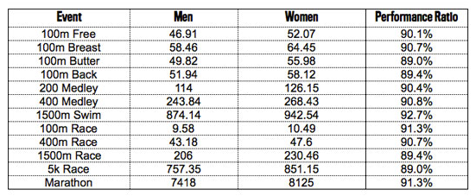
A comparison of male and female world record times in different events. If a smaller heart and lungs is the cause for lower performance in endurance events, what is the cause in shorter, higher intensity events?

Slide 6
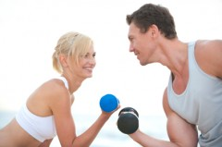
Muscle Mass
As women tend to have a higher percentage of body fat…
…they subsequently have a lower percentage of muscle mass.
This results in a lower level of muscular strength and power (as much as 50%).

Slide 7
Flexibility
Having less muscle mass has a huge benefit for flexibility.
Women tend to be far more flexible than men.

Slide 8
Maturity
This is regarding physical maturity rather than mental maturity.
Girls tend to mature at a faster rate/ earlier than boys.
From the age of 11 boys begin to take over in height and strength.

Slide 9
Chemical Differences
Women can be disadvantaged if competing during menstruation.
The chemical changes during this time can affect an individual’s ability to perform at optimal levels.
This is obviously something that doesn’t affect males, although there are chemical changes that can affect performance to a lesser extent in males.

Slide 10
Body shape, size and physique
 | Male | Female
Height | Taller | Smaller
Pelvis | Narrower | Wider (For childbirth)
Lungs and heart | Larger | Smaller
Body fat % | Lower (15%) | Higher (25%)

Slide 11
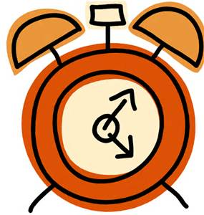
In groups of 3 Brainstorm 15 female and 15 males that are either professional . Athletes . Coaching . Referees . Commentators . Television presenters (Try and include professionals from each category )
2 minuets to complete

Slide 12
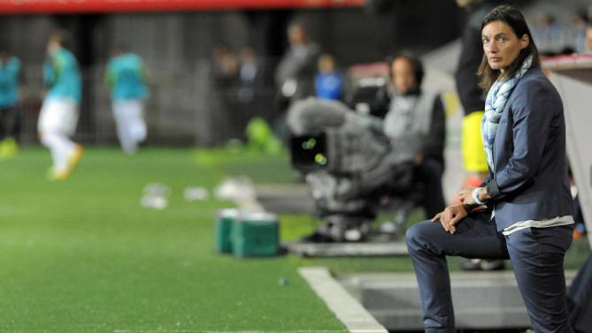
Opportunity
Do women have the same opportunities in sport as men?
Female Football commentator
Coaching?
Refereeing?
Commentating?
Television?

Slide 13
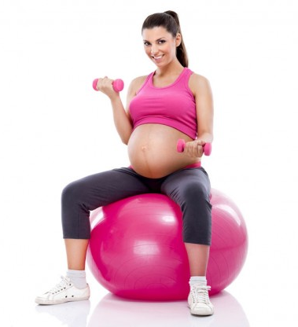
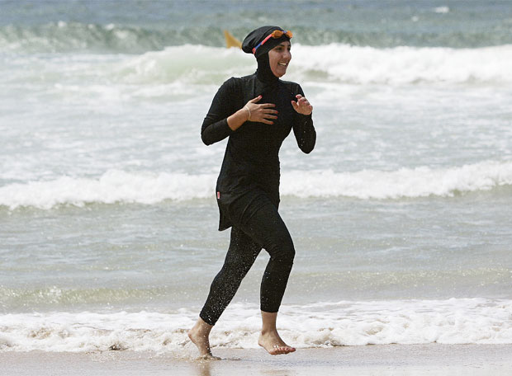
Restrictions
How are women restricted in sporting participation compared to men?

Slide 14
EXAM Questions
1. Give three physical differences in a male and female (3 marks)
2. Provide a sporting example of how one of these physical differences can be a advantage to the performers performance if both genders were competing against one another (3 marks)

