Slide 1
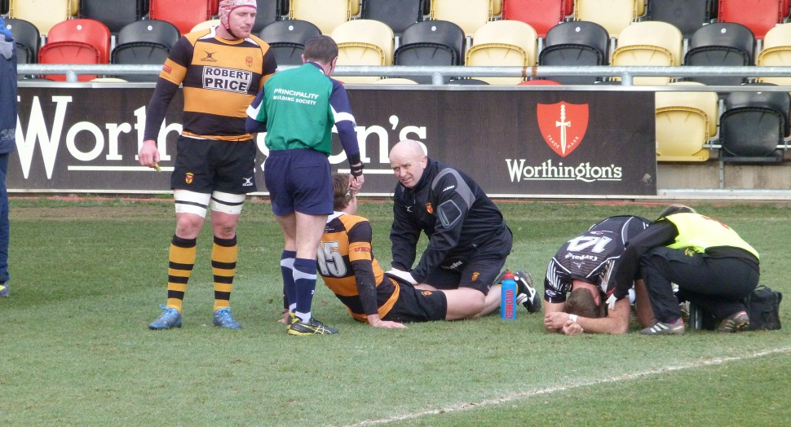
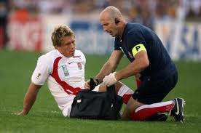
Injury and First Aid
Learning Objectives:
To consider the types of sports injuries that can occur and how these can be prevented.
To understand the action to be taken if an accident or emergency occurs.

Slide 2
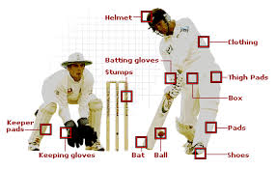
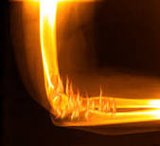
Injury
Most performers get injured at some point. Injury prevention is therefore essential to minimise risk.
Incorrect technique can often be a cause of injury.

Slide 3
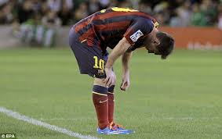
Internally caused injuries
These are injuries where a performer is solely responsible:
Overuse injuries – caused by training or playing too much. Include stress fractures and muscle / tendon injuries. E.g. tennis elbow.
Sudden injuries – caused by strain put on the body. E.g. pulled hamstring.

Slide 4
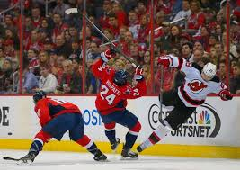
Externally caused injuries
These are injuries caused by something else such as equipment, opponents or weather conditions.
Foul play or incorrect actions (inc poor technique) – these injuries can be quite serious which is why rules are in place to prevent them.
Impact injuries – many sports allow physical contact (e.g. rugby) and impact can also occur with equipment.
Equipment / clothing – damaged, faulty or bad fitting equipment (e.g. trainers) can cause injury.
Accidents – no matter what precautions are taken, injury can still occur.

Slide 5
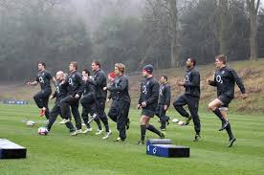
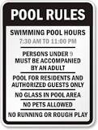
Precautions
Risk assessment
Warm-up prior to starting activity
All rules or codes of conduct should be clear, followed and enforced.

Slide 6
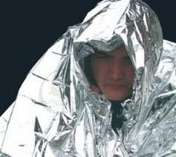
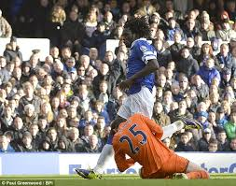
Common Injuries
Head injuries – make sure the person can breathe and put them into recovery position. Concussion may be apparent from loss of consciousness, weak pulse, shallow breathing and dilated pupils.
Fractures – broken bones.
Hypothermia – rapid cooling of the body. Ensure the person is covered with warm, dry clothing or blankets.
Cuts – vary in size and seriousness but should be dealt with by cleaning and covering.

Slide 7
Joint and muscle injuries – these include sprains (damage to ligaments at a joint) and strains (damage to a muscle) and should be treated with RICE.
Rest – stop the activity immediately.
Ice – apply ice to reduce swelling and relieve pain.
Compression – apply pressure to injured are to reduce swelling.
Elevation – raise injured area to decrease circulation to that area.
These principles apply to all soft tissue (ligament, tendon or muscle) injuries.

