Slide 1
Leisure and Recreation
Learning Objectives:
To understand the difference between leisure and recreation
To be able to describe different types of leisure and recreation activities

Slide 2
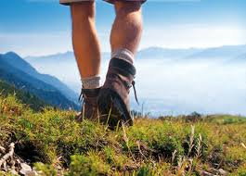
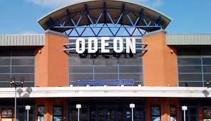
Leisure
Task: With a partner try to come up with a definition for ‘leisure’.
‘Leisure is your free time when you can choose what to do.’ (time when you are not working, eating, sleeping, cooking etc)

Slide 3
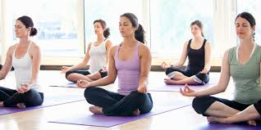
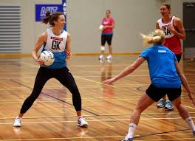
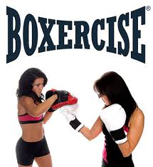
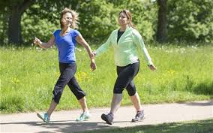
Active Leisure
Activities that involve physical or mental exertion.
These can be ‘low-impact’ or ‘high-impact’ activities. (categorise the 4 pictures below)

Slide 4
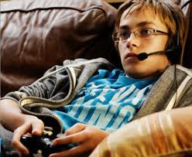
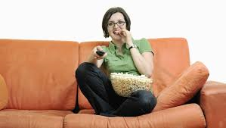
Passive Leisure
Activities which do not involve exerting any significant levels of physical or mental effort.
What are the problems associated with passive leisure activities?

Slide 5
Leisure Time Available
Leisure time has increased greatly through time for a variety of reasons including:
Technological advances (washing machines etc)
Higher levels of unemployment
Shorter working day/week
Part-time and shift work

Slide 6
Leisure Provision
Local councils have a legal responsibility to provide leisure services.
List as many as you can in your local area.
Private enterprises also run sport-related facilities but only if a profit can be made. Therefore urban areas generally have better facilities than rural areas.

Slide 7
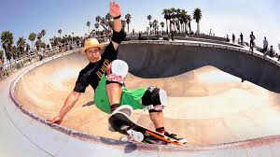
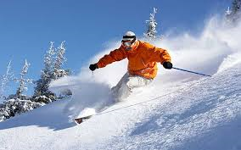
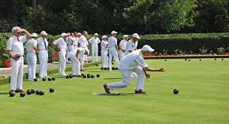
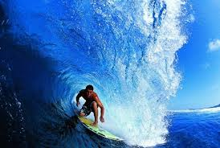
Recreation
Physical recreation is taking part in physical activity for intrinsic reward rather than extrinsic reward.
The activities we choose to participate in recreationally differ due to the following factors:
Age
Location
Provision and cost

Slide 8
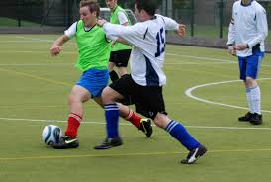
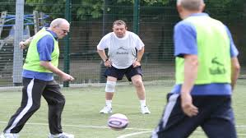
Outdoor Recreation –
activities associated with some degree of challenge with the natural environment such as caving, rock climbing, sailing, windsurfing etc.
Lifelong Sports –
activities which can be participated in at any age. Sports such as swimming will have sessions targeted at different age groups to maximise participation levels.

