Slide 1
Methods of Training
Learning Objectives:
To know the different elements of an individual training session.
To be able to name and explain five methods of training.

Slide 2
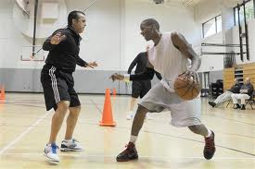
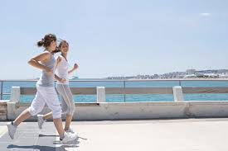
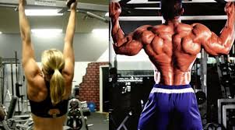
Aspects of a Training Session
Warm-up
Fitness or exercise phase
Skills or team-play phase
Warm-down (cool down)

Slide 3
Warm-Up
The first phase of a training session.
A pulse raiser (e.g. light jog) increases heart rate and breathing rate so that oxygen can be supplied to working muscles.
It also allows for psychological preparation.
Stretching reduces the possibility of being injured. Cold muscles are more prone to fibre and tendon damage.
Warm ups should be specific to the activity.

Slide 4
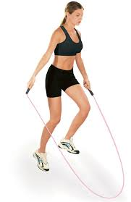
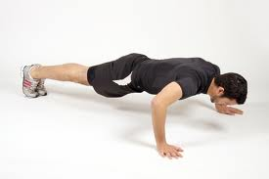
Fitness Phase
This phase focusses on one or two components of fitness (e.g. stamina or strength)
The principles of training must be followed.

Slide 5
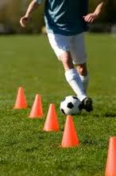
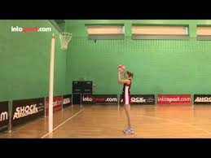
Skill Phase
Practice of the skills involved in the game (e.g. netball shooting practice).
This phase could also involve the practice of team tactics etc.

Slide 6
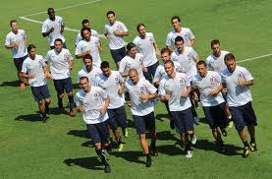
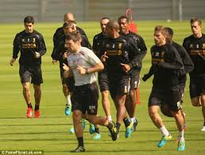
Cool-down
Each session should finish with gentle activity (e.g. light jog) to cool down.
This helps the body to recover by aiding the removal of lactic acid and other waste products to avoid muscles feeling sore.

Slide 7
Thresholds of Training
Training sessions should be made specific to the individual.
Factors such as age, experience, fitness levels, ability levels and motivation levels need to be considered.
Training thresholds are used to determine whether training is aerobic or anaerobic.
Aerobic training = 60-80% Max HR
Anaerobic training = 80-90% Max HR

Slide 8
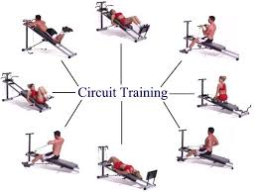
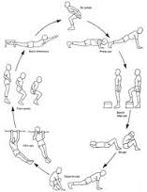
Circuit Training
Circuit training is very popular because it is easy to set up and very flexible.
Circuits involve a series of stations.
Each station should be clearly marked with the exercise accurately demonstrated.
Exercises should be varied and stations which work the same muscle groups should be well separated.

Slide 9
Circuit Training
Fitness Circuit
Primary aim is to improve fitness.
Exercises could include: press ups, sit ups, skipping, tricep dips, shuttle runs etc.
Requires little specialised equipment and is easy to set up (but may need large space).
Skills Circuit
Also uses stations but exercises are focussed on improving skills.
E.g. A basketball circuit involving dribbling through cones, lay ups etc.

Slide 10
Running a Circuit
Timed circuits – a set time on each station E.g. 30secs. Complete as many exercises as possible in the time. Rest periods inbetween.
Fixed load – complete a certain number of exercises (E.g. 10 press ups) on each station without a time limit.
Varied laps – changing the load or time limit for each lap of the circuit.

Slide 11
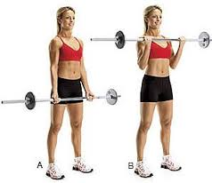
Weight Training
Used to improve muscular strength, muscular endurance and power.
Also improves muscle size, muscle tone and can assist in injury recovery.
Effective weight training involves the principle of overload.
Repetitions – number of times the weight is moved.
Sets – a complete set of repetitions.

Slide 12
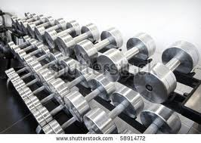
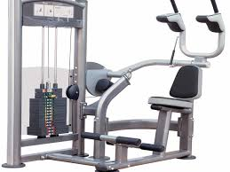
Weight Training
To increase muscular strength decrease the number of reps and increase the weight (e.g. 6 reps at near max weight).
To increase muscular endurance increase reps and decrease weight (e.g. 20-30 reps at 40-60% of max weight).
To increase power complete 10-15 reps performed at speed with 60-80% of max weight.

Slide 13
Types of Weight Training
Free Standing Weights
Cheap and easy to acquire for individuals.
Allows for huge variety of exercises.
Safety issues must be considered and weight training should always be done with a partner.
Specialised Weight Training Equipment
Often found in specialist gyms and leisure centres.
These can be expensive but are much safer to use.

Slide 14
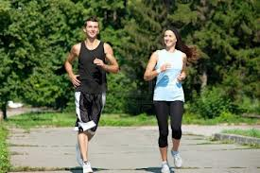
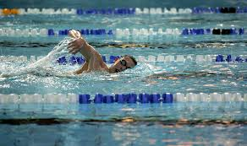
Continuous Training
Training which keeps heart rate high over a sustained period of time.
Activities could include jogging, cycling, swimming.
Great for improving cardiovascular fitness.
Easily done in gyms using treadmills, exercise bikes, cross trainers etc.

Slide 15
Interval Training
Training with periods of high intensity work followed by periods of rest.
Long interval training – work periods of 15s-3mins at 80-85%max effort. Excellent for games players.
Short interval training – short periods of work (up to 15s) but at maximum levels. Longer rest required. Excellent for racket sports and sprinters.

Slide 16
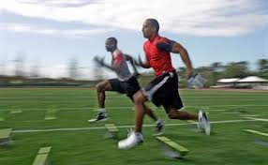
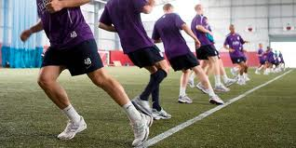
Fartlek Training
Swedish word for ‘speed play’
Form of interval training including walking, jogging and sprinting.
Continuous Shuttle Run
The multi stage fitness test (bleep test)
A fitness test but can also be used as a method of continuous training.

Slide 17
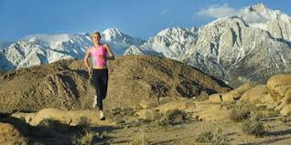
Altitude Training
Aerobic exercise performed at high altitude.
At altitude the pressure of oxygen is lower so it is harder to get oxygen to the working muscles.
The body compensates for this by creating more red blood cells to improve the oxygen-carrying capacity of blood.
This leads to great improvement when back at sea level.
Used by endurance athletes.

