Slide 1
GCSE Physical Education Unit: School, Sport & Participation Topic: National Curriculum
Learning Objective:
To be able to name 4 organisations that promote participation in sport and describe how they achieve their aims.

Slide 2
Exam Question
One example of a career in sport may involve working for Sport England. Describe the aims of Sport England and explain what they do to achieve their aims. ( 5 marks )

Slide 3
National Governing Bodies (NGB’s)
The organisation that oversees a sport at national level.

Slide 4
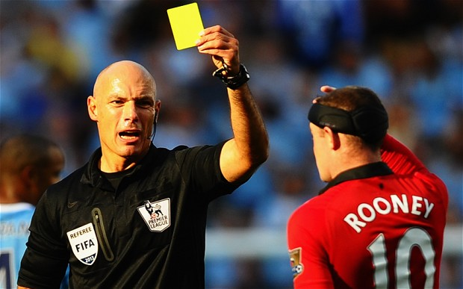
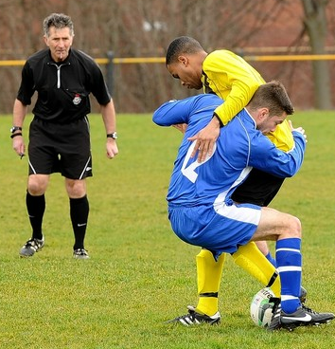
NGB’s
Provide and support:
Coaching
Courses to improve quality of coaching.
Officiating
Courses to educate and improve officials as well as assigning officials to matches and tournaments.
Talent Development
Help to improve the standard of performers.
Competition
Provide competition at all levels; from junior to senior and from grass roots to elite level.
For each of these areas what do NGB’s do?

Slide 5
Sport England
Their aim is to increase the number of people participating in sport and to make lives better through sport.
Their role includes:
Provide funding and facilities
Measuring participation
Identifying target groups

Slide 6
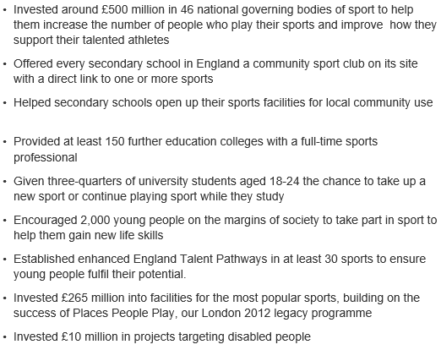
By 2017 they aim to have…

Slide 7
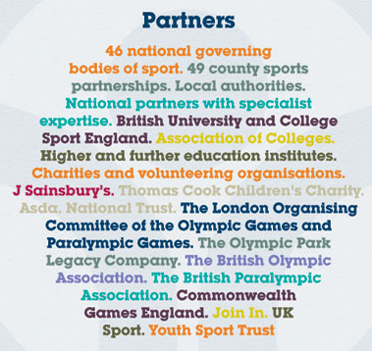
Sport England
Current target groups are 14-25 year olds.
£1 billion will be invested to achieve targets.

Slide 8
Sport England
There are different initiatives and programmes at local and national level that are specific to certain groups. For example:
This Girl Can
Sainsbury School Games
Satellite Clubs

Slide 9
Youth Sport Trust
“An independent charity devoted to changing young people’s lives through sport”
Their 3 main aims are to:
give every child a sporting start in life through high quality PE and sport in primary schools;
ensure all young people have a sporting chance by developing opportunities for those with special educational needs and disabilities; and
support all young people to achieve their sporting best in school and their personal best in life.
Sport Changes Lives

Slide 10
Dame Kelly Holmes Legacy Trust
Charity set up by Dame Kelly Holmes
She became the first British female athlete to win 800m and 1500m Olympic gold in Athens, 2004.
“We get lives on track by using world class athletes to engage, enable and empower disadvantaged young people.”

Slide 11
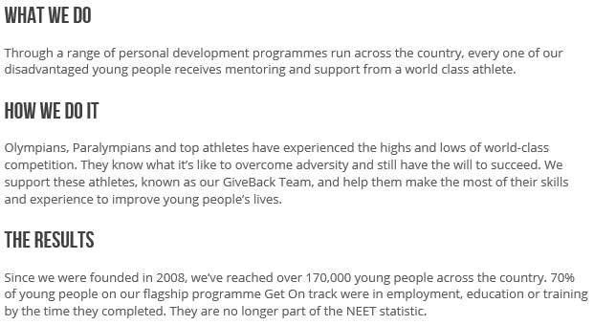
Some stories of the work performed by the charity!

Slide 12
Exam Question
One example of a career in sport may involve working for Sport England. Describe the aims of Sport England and explain what they do to achieve their aims. ( 5 marks )
Aims:
Increase the number of people taking part in sport (1)
Improve lives through sport (1)
They:
Provide funding and facilities (1)
Measure participation (1)
Identify target groups (1)

