Slide 1
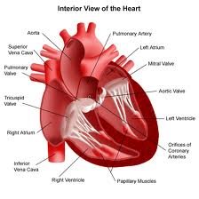
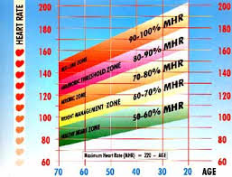
The Circulatory System
Learning Objectives:
To be able to label the circulatory system.
To know the functions of the heart and blood vessels.
To understand how cardiovascular endurance can be measured and improved.

Slide 2
The Circulatory System
The circulatory system includes the heart, the blood and the blood vessels.
Its functions are:
The blood carries oxygen, water and nutrients throughout the body and transports and removes waste.
Protection is provided when antibodies that fight infection are carried in the blood. Blood can also clot to seal cuts and wounds.
Body temperature is regulated as the blood absorbs body heat and carries it to the lungs and skin where it is released.

Slide 3
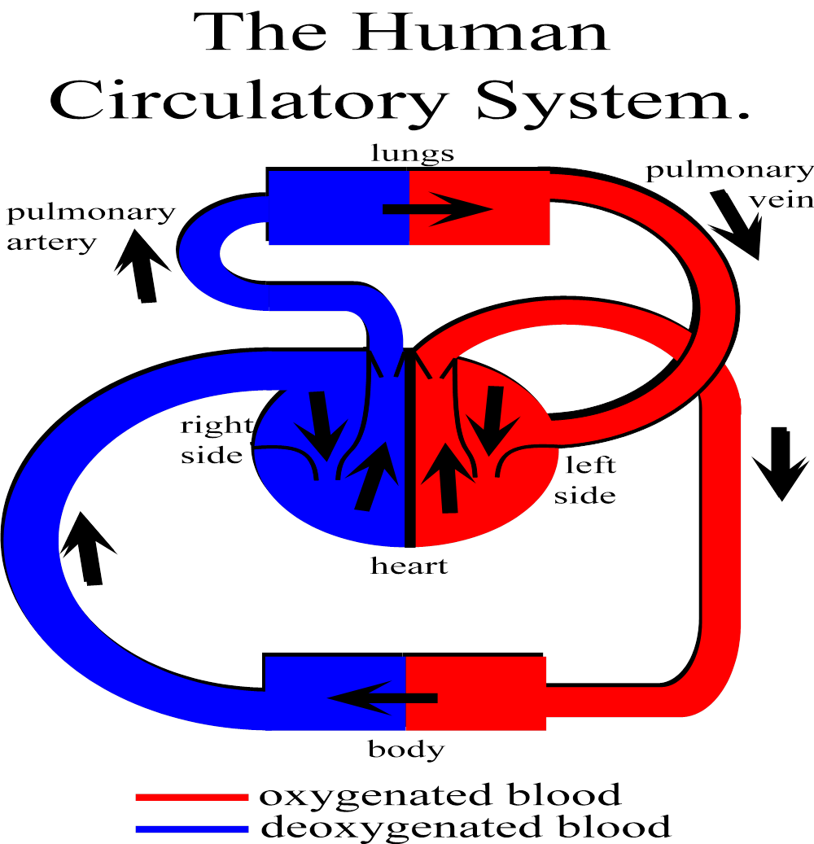
Aorta
Vena Cava

Slide 4
Circulatory System Facts
The right side pumps deoxygenated blood to the lungs for oxygen uptake
The left side pumps the oxygenated blood to the body
Arteries carry blood away from the heart. The aorta is the largest artery
Veins carry blood back to the heart. The vena cava is the largest vein
The pulmonary artery is the only artery carrying deoxygenated blood.
Remember, since you are looking at the heart, R is on the left

Slide 5
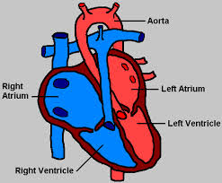
The Heart
The heart is a muscle.
The average heart beats 72 times per minute at rest.
Heart rate increases with exercise due to greater demand for oxygen and requirement to remove waste products.
Important terms:
Heart rate – number of beats per minute.
Stroke volume – amount of blood pumped out of heart per beat.
Cardiac output – amount of blood pumped out of the heart per minute.

Slide 6
Blood Vessels
There are 3 types of blood vessel:
Arteries – carry oxygenated blood away from the heart via the aorta. Have thick, elastic walls and carry blood at high pressure. They do not have any valves. The pulse is located in arteries.
Veins – carry deoxygenated blood back to the heart. Have thinner, less elastic walls. Have valves to prevent backflow.
Capillaries – microscopic vessels which allow oxygen and carbon dioxide to pass through their walls.
Circulatory System summary song!

Slide 7
Cardiovascular Endurance
Cardiovascular endurance training clip
The ability of the heart and lungs to keep supplying oxygen to the muscles to provide the energy required to sustain physical movement.
Prolonged exercise will result in:
An increased heart rate.
An increased breathing rate.
An increase in blood pressure (the force of circulating blood on the walls of arteries).

Slide 8
Improving Cardiovascular Endurance
This is achieved by making the heart and lungs work harder. They will then adapt resulting in an improvement in endurance levels.
Athletes ensure that this is being done by working in a ‘training zone.’
A training zone is the range of heart rate within which a specific training effect will take place.

Slide 9
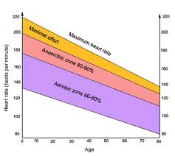

Slide 10
Training Zones
Maximum heart rate (MHR) can be calculated using 220 – age.
This number can then be used on the graph to determine the intensity level at which an athlete is working.
This knowledge is essential so that a sportsperson knows they are training appropriately.
Training in the aerobic zone is the most effective way for improving the cardiovascular system.

Slide 11
Testing Cardiovascular Endurance
Resting pulse rate is a general indicator of stamina levels. A lower resting pulse indicates higher stamina levels.
The quicker that pulse rate recovers to normal levels following exercise indicates higher stamina levels.
These factors can be monitored over a period of time to assess cardiovascular endurance.

