Slide 1
The Respiratory System
Learning Objectives:
To understand the difference between aerobic and anaerobic respiration.
To understand how breathing occurs
To understand the recovery process
Respiratory youtube clip

Slide 3
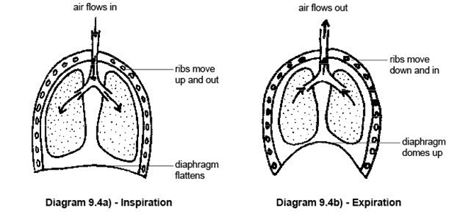

Slide 4
The Action of Breathing
Inspiration:
Diaphragm flattens
Intercostal muscles lift rib cage up and out
Sternum pushed outwards
Chest cavity enlarges
Pressure in chest reduces so air flows in
Air coming in is high in O2 (and N) but low in CO2
The reverse of this occurs for expiration

Slide 5
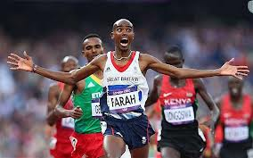
Aerobic Respiration
Respiration which occurs in the presence of oxygen.
glucose + O2 = energy + CO2 + water
Requires a constant supply of O2 and is used during long continuous activity. Vital for activities such as long distance swimming, running and cycling.

Slide 6
Gaseous Exchange
The process where oxygen is taken from the air and exchanged for carbon dioxide.
This process occurs in the small air sacs called alveoli.
During exercise breathing rate and depth increases.

Slide 7
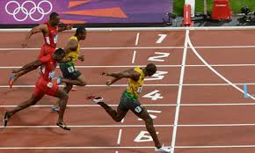
Anaerobic Respiration
Respiration which occurs in the absence of oxygen.
Glucose energy + lactic acid
Used for activities where there is not enough time to take in oxygen for respiration and it is therefore only used for short burst activities such as 100m sprinting.
Team sports generally involve a mixture of aerobic and anaerobic respiration.

Slide 8
Oxygen Debt
Occurs as a result of anaerobic respiration during vigorous exercise.
Anaerobic respiration can only last for around 60 secs.
This causes a build up of lactic acid which makes muscles hurt.
After this breathing rate increases to get oxygen into the body to aid with recovery.
The increased breathing rate also helps to remove carbon dioxide.
Respiratory System summary song!

